Slide 1
Design
Notebook

Slide 2
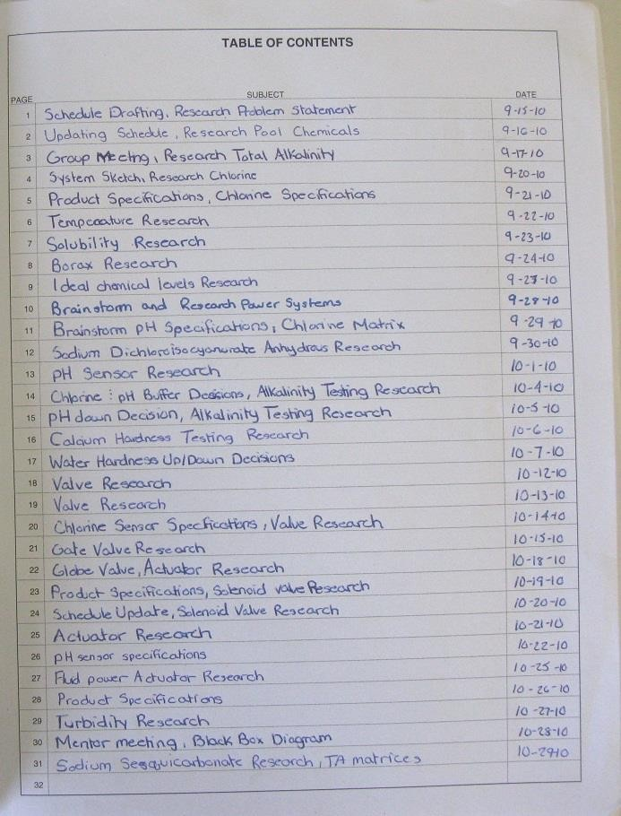
Design Notebook Sections
Title Page
Table of Contents
General Chronological Entries
References
Business/Expert
Contacts

Slide 3
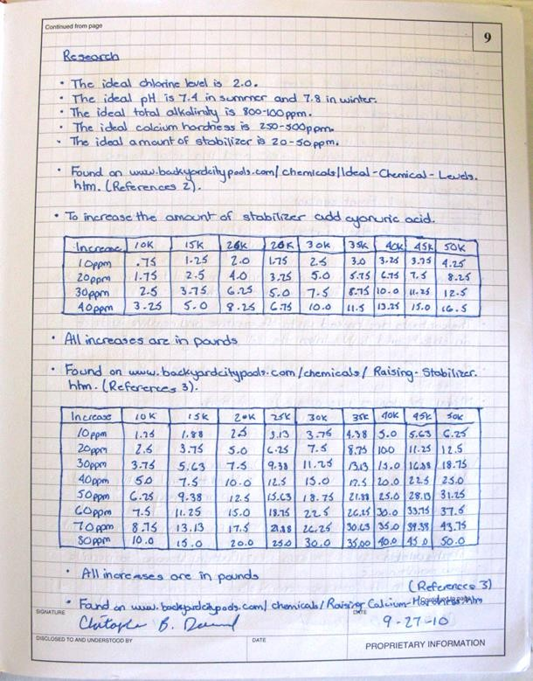
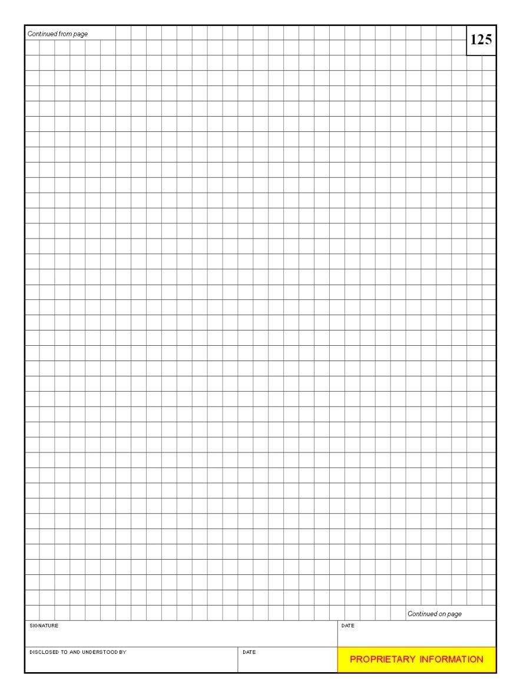
Standard Page Layout
Quad ruled paper
All pages are
  Numbered
  Dated
  Signed by the designer
  Signed by a witness
  Include a statement of the proprietary nature of notebook

Slide 4
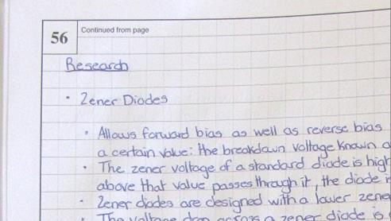
Best Practices
All work is in pen.
Markers that bleed through the paper are not used.
Pages are sequentially numbered in ink on the top outside edge.
Notebooks are bound.
  Cannot add pages
  Cannot remove pages

Slide 5
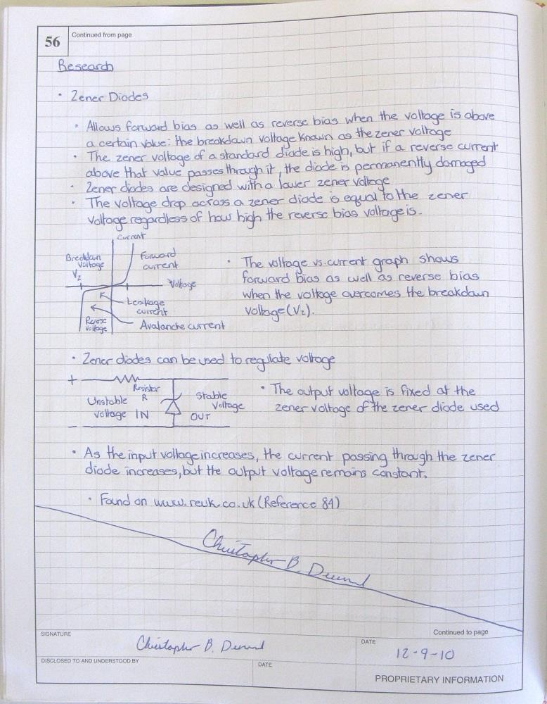
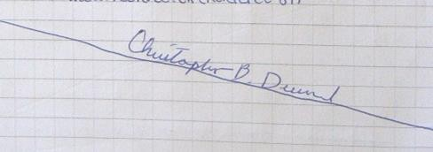
Best Practices
Entries begin at the top of the page, working left-to-right and top-to-bottom
Do not leave blank space. If there is extra space, draw an
X or a line across it
and sign.

Slide 6
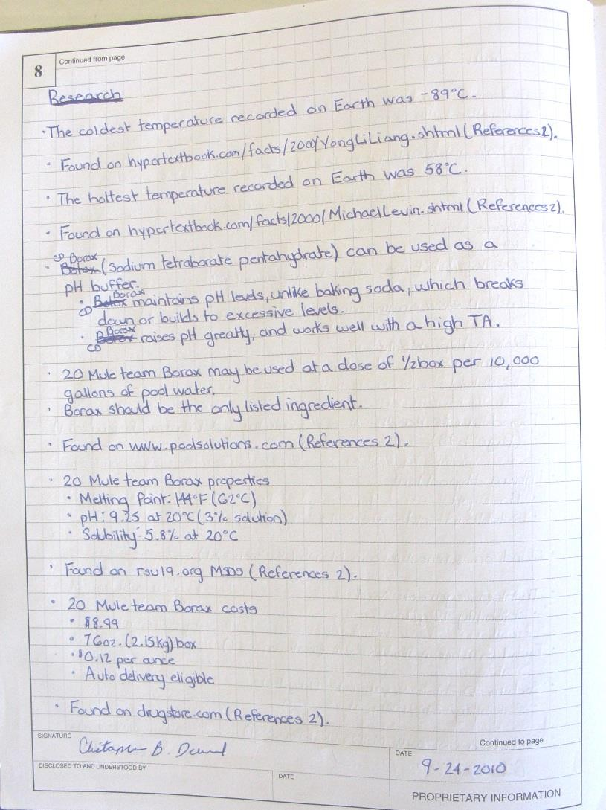
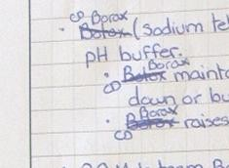
Best Practices
If you make a mistake, draw a line through it, enter the correct information, and initial the change.
Never erase or remove anything.

Slide 7
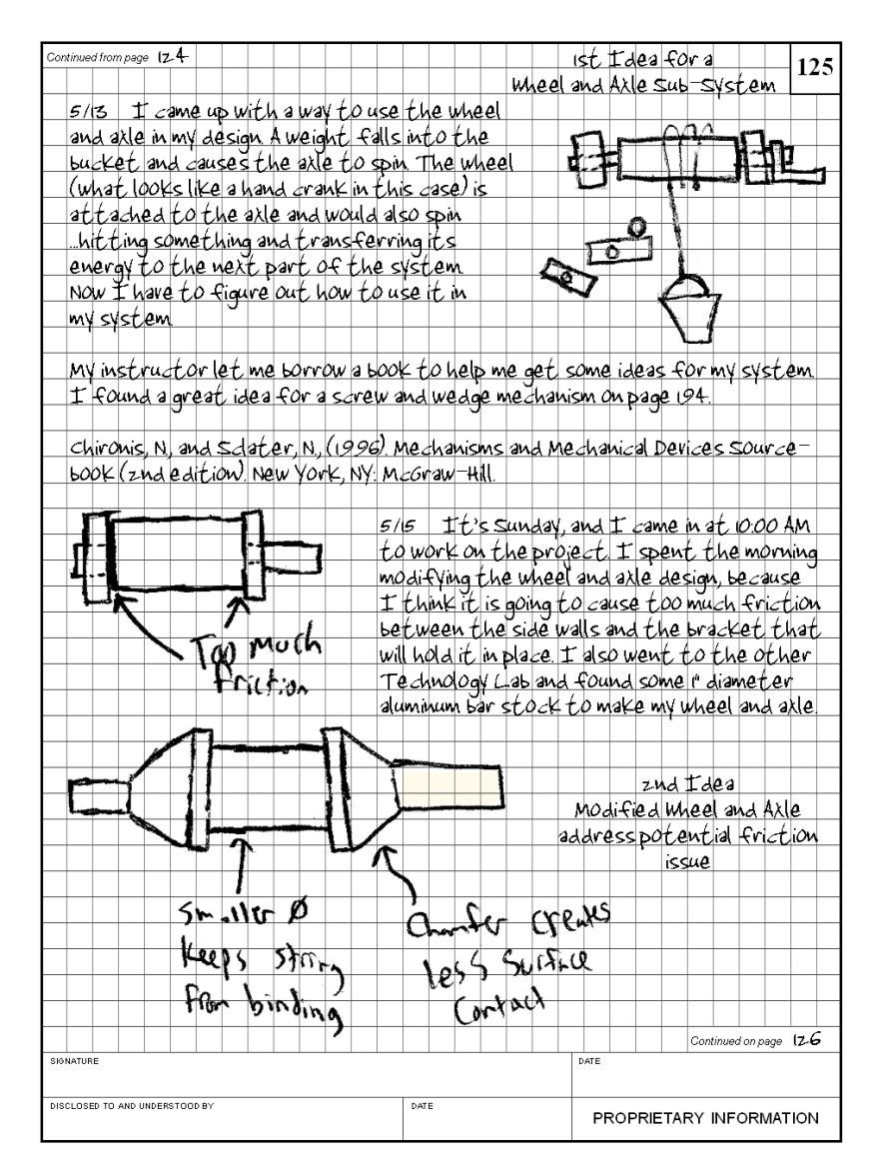
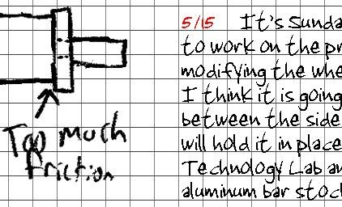
Best Practices
Date each entry

Slide 8
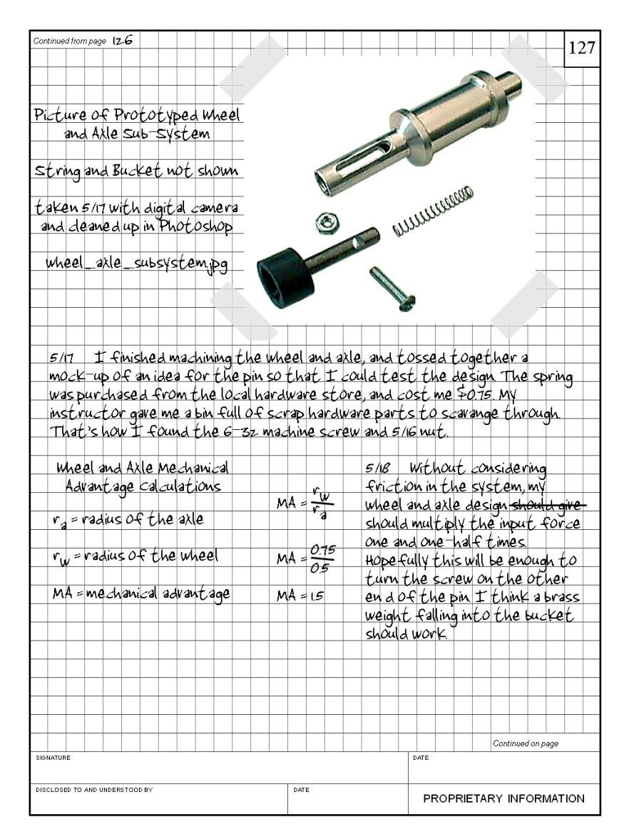

Best Practices
Inserted items are
permanently attached
  Glue is preferred
  No loose leaf items
Sign your name so that it extends across both the notebook page and the inserted document.

Slide 9
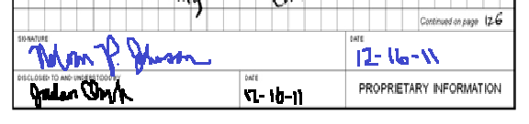
Best Practices
Sign and date each page before the next
page is started.
A colleague or mentor should corroborate the events and facts on each page and sign as a witness.
Store the notebook in a safe location.

Slide 10
Best Practices
Sketches
  Label all parts of the
sketch
  Describe each sketch

Slide 11
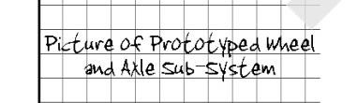
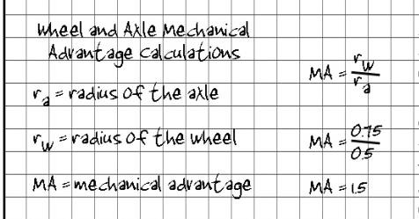
Best Practices
Calculations and figures are clearly labeled.

Slide 12
Best Practices
Progress Entries
  Reflect on tasks accomplished, successes, and failures
  Reflect on future needs and tasks to be completed

Slide 13
Best Practices
Be NEAT,
be ACCURATE, be LEGIBLE,
and be THOROUGH.

Slide 14
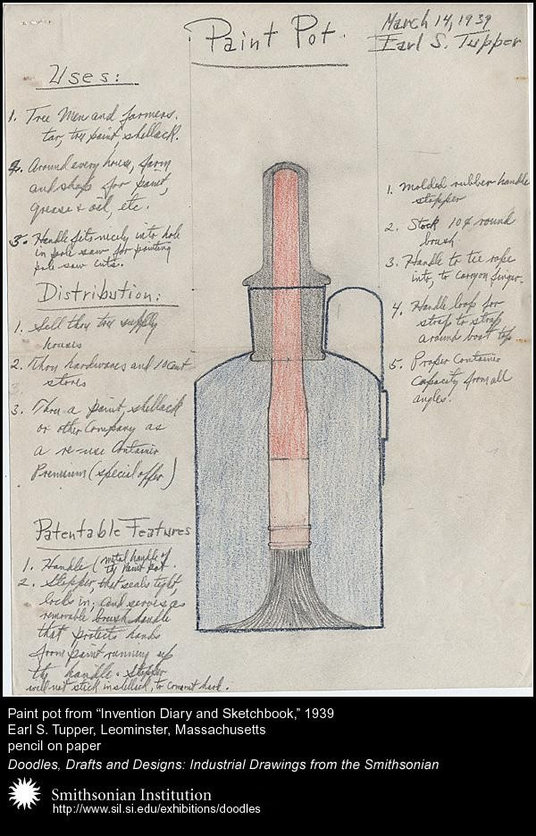
Historical Example
Page from Earl Silas Tupper’s (1907 - 1983) “Invention Diary and Sketchbook”
Mr. Tupper developed a wide range of inventions, including Tupperware
Courtesy of Smithsonian Institute: http://sil.si.exhibitions\doodles

Slide 15
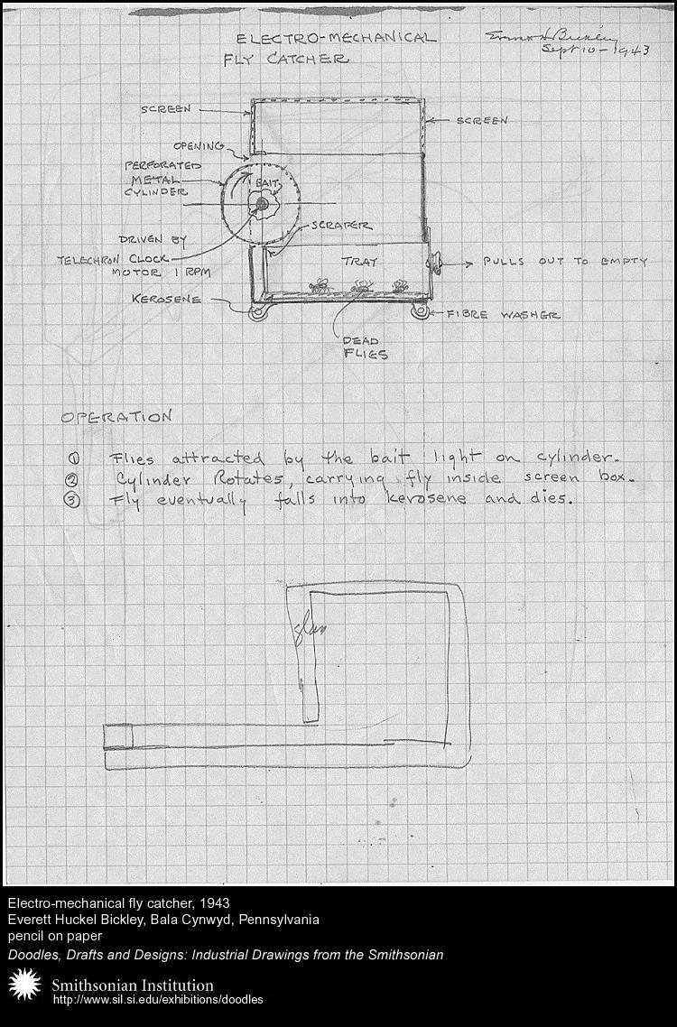
Historical Example
Everett Huckel Bickley (1888-1972) original design notes, for an electro-mechanical fly catcher, 1943
Mr. Bickley developed dozens of inventions. His most lucrative invention was a bean-sorting machine that separated good beans from bad.
Courtesy of Smithsonian Institute: http://sil.si.exhibitions\doodles

Slide 16
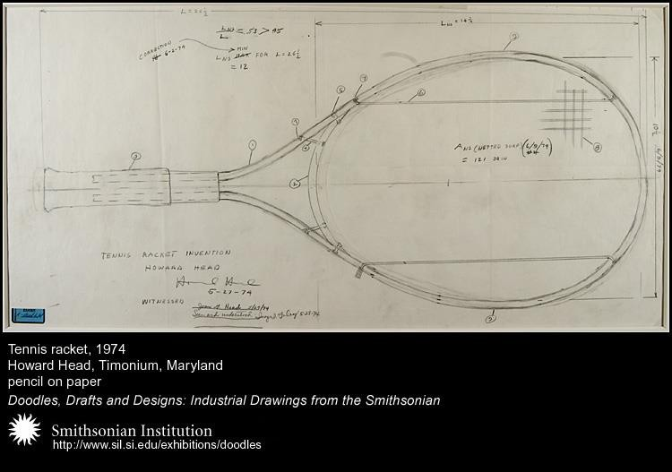
Historical Example
Howard Head (1914 – 1991) original design for an over-sized tennis racket, 1974
The larger racket more than doubled the sweet spot of the traditional racket

