Slide 1
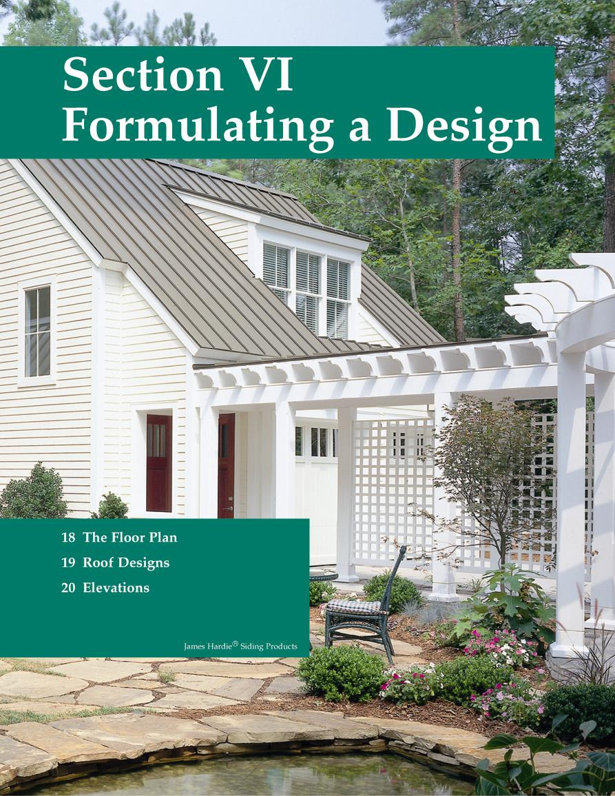
Chapter 22
Elevations

Slide 2
Introduction to Elevations
An elevation is an orthographic projection drawing of one side of a building.
Purpose is to give vertical dimensions and show the finished appearance.
Generally four elevations are drawn.
Exterior materials are shown.

Slide 3
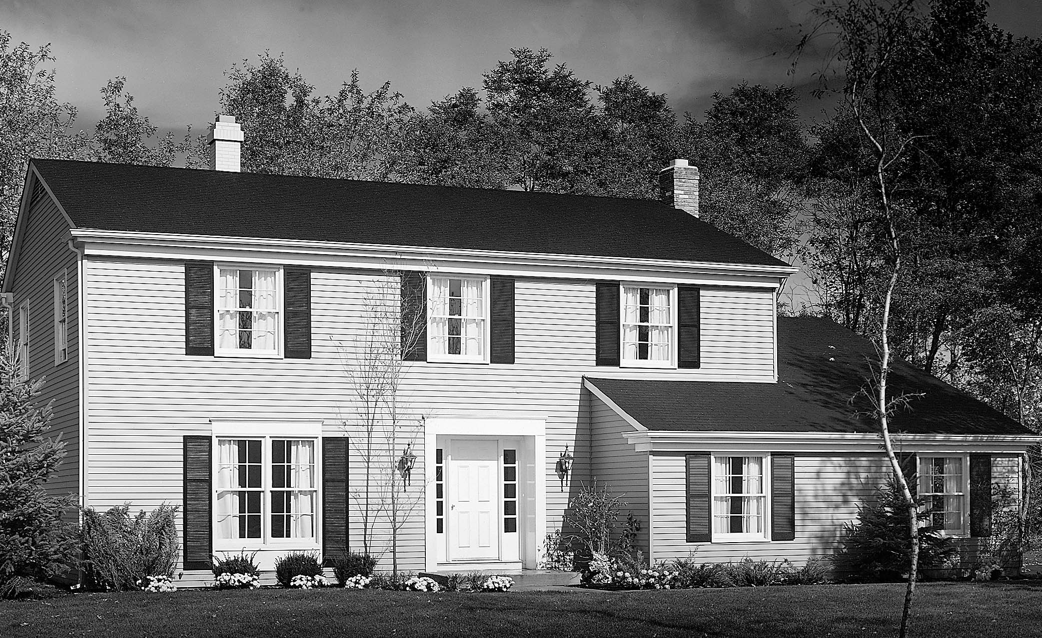
Introduction to Elevations
Photograph of a residence.

Slide 4
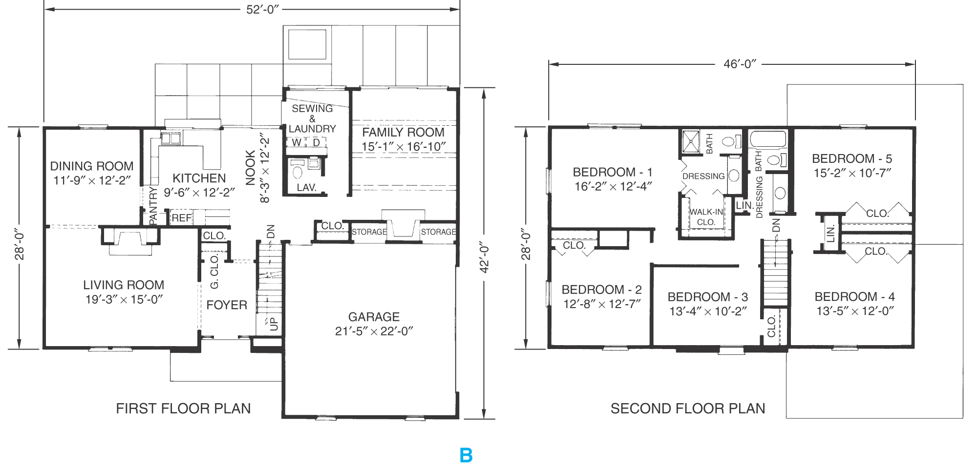
Introduction to Elevations
Floor plan of the residence shown in the previous slide.

Slide 5
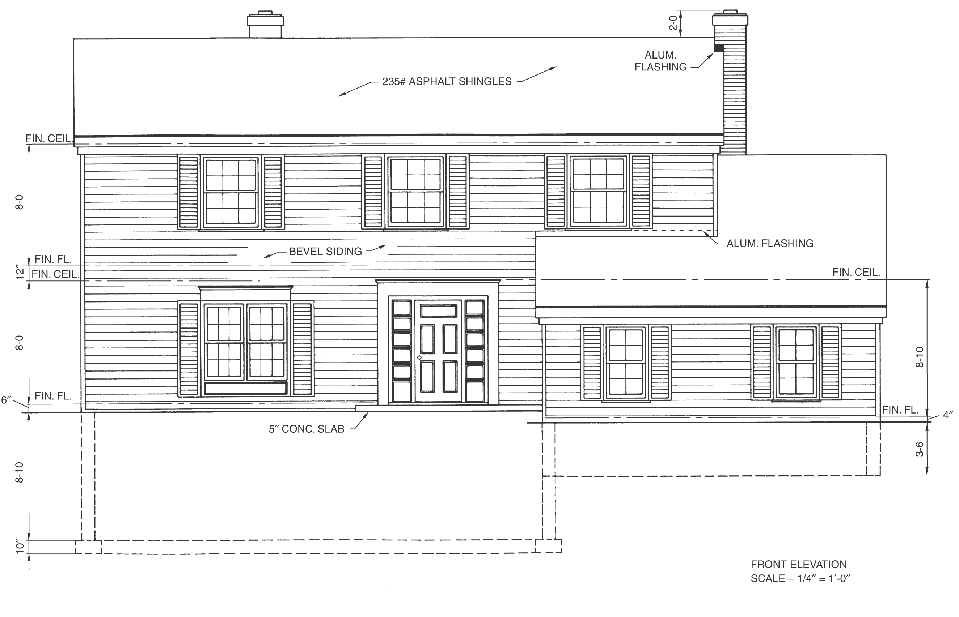
Introduction to Elevations
Front elevation drawing for the residence shown in the previous slides.

Slide 6
Required Information
Features that should be included on the elevations:
  Side of house represented.
  Grade lines.
  Finished floor and ceiling levels.
  Exterior wall corners.
  Windows and doors.

Slide 7
Required Information
  Roof features.
  Vertical dimensions of important features.
  Porches, decks, and patios.
  Material symbols.
  Dimension notes and symbols.
  Title block and scale.

Slide 8
Elevation Identification
Each elevation must identify the wall represented.
Two methods are commonly used:
  Front, rear, right side, and left side.
  North, south, east, west.
Identify each elevation immediately below the drawing.

Slide 9
Grade Line, Floors, and Ceilings
The grade line is the reference point for most elevations.
  Plot plan shows the existing grade.
  Draw features below grade as hidden lines.
Show floor-to-ceiling heights.
Top of foundation wall should be at least 8" above the grade.

Slide 10
Walls, Windows, and Doors
Show all visible wall corners as object lines.
Draw a wall section to identify vertical heights needed for the drawing.
Include windows and doors that are visible on the exterior wall.
Tops of windows and doors are usually 6'-10" from the top of the subfloor.

Slide 11
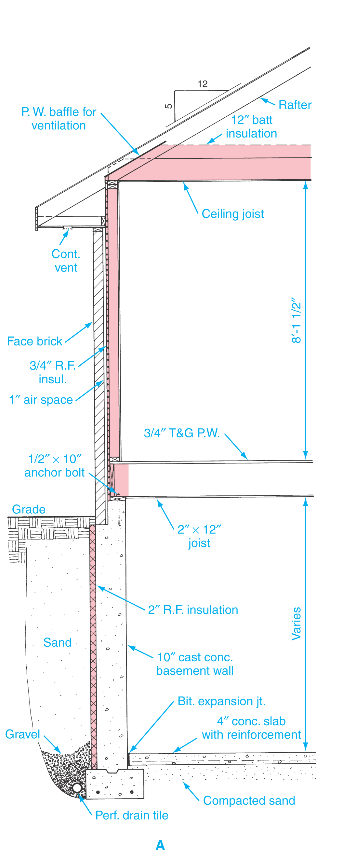
Typical Brick Veneer Wall Section

Slide 12
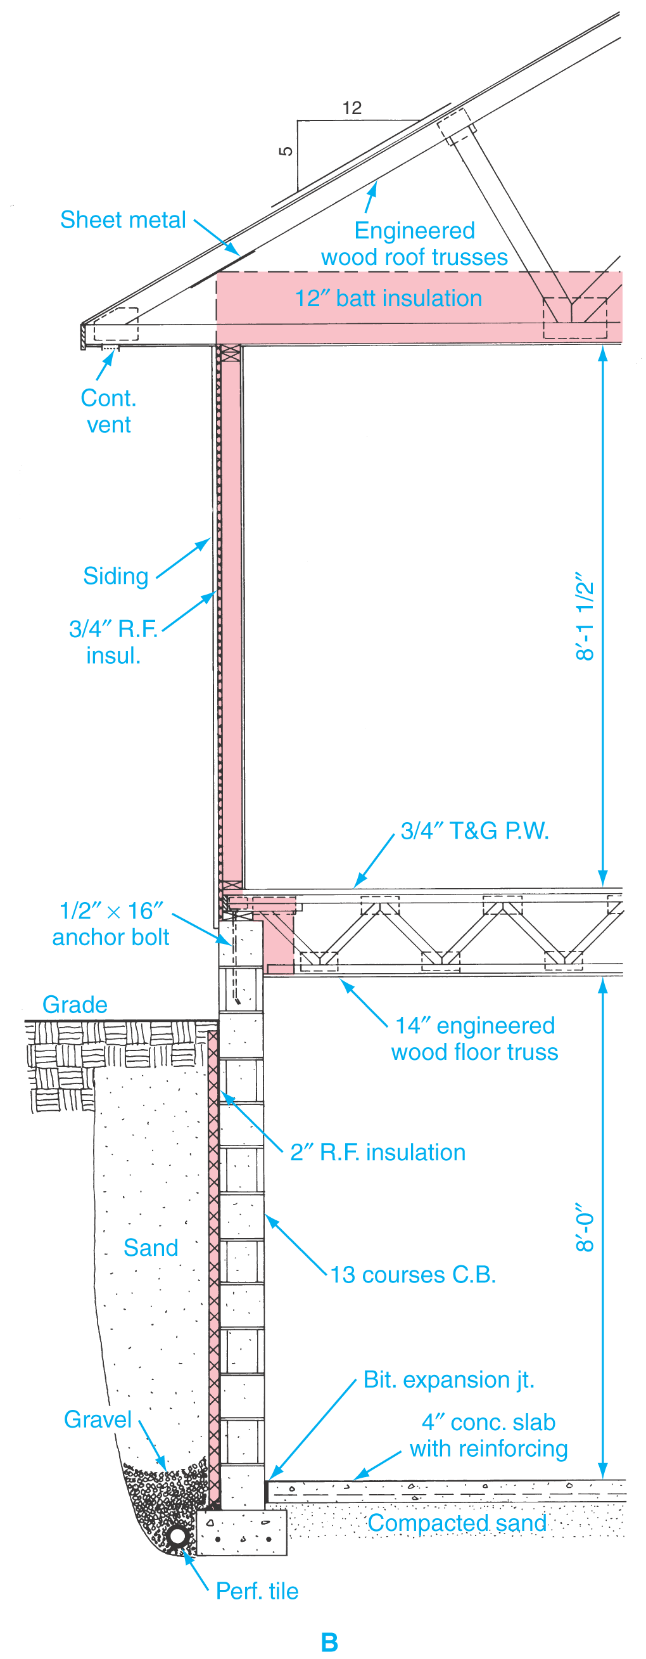
Typical Frame Wall Section

Slide 13
Roof Features
Roof features should be shown on an elevation drawing.
Show the roof style and pitch.
Show chimney height and size.
Draw gable ends first to determine roof height; the highest section first.
Show chimney flashing, roof covering material, and gable ventilators.

Slide 14
Dimensions, Notes, Symbols
Dimensions on an elevation drawing are mainly height dimensions.
  All features must be dimensioned.
Notes provide additional information.
Several standard symbols are commonly used on elevations such roof pitch symbol, exterior materials, window swing symbols, and cutting-plane lines.

Slide 15
Drawing a Typical Wall Section
An accurate typical wall section is needed to construct accurate elevations.
Sequential Steps
  1. Gather the necessary information and
  choose a scale.
  2. Lay out the footing, foundation wall, and
  floor slab.

Slide 16
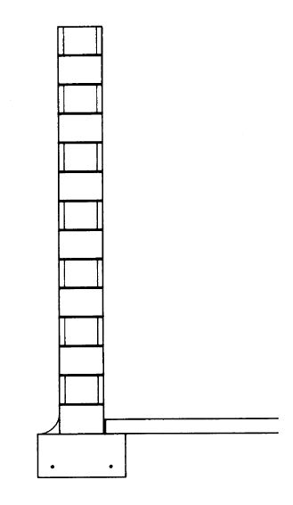
Drawing a Typical Wall Section
Steps 1 and 2.

Slide 17
Drawing a Typical Wall Section
Sequential Steps
  3. Draw the first floor, wall, and roof structure
  showing building components in their
  actual size.

Slide 18
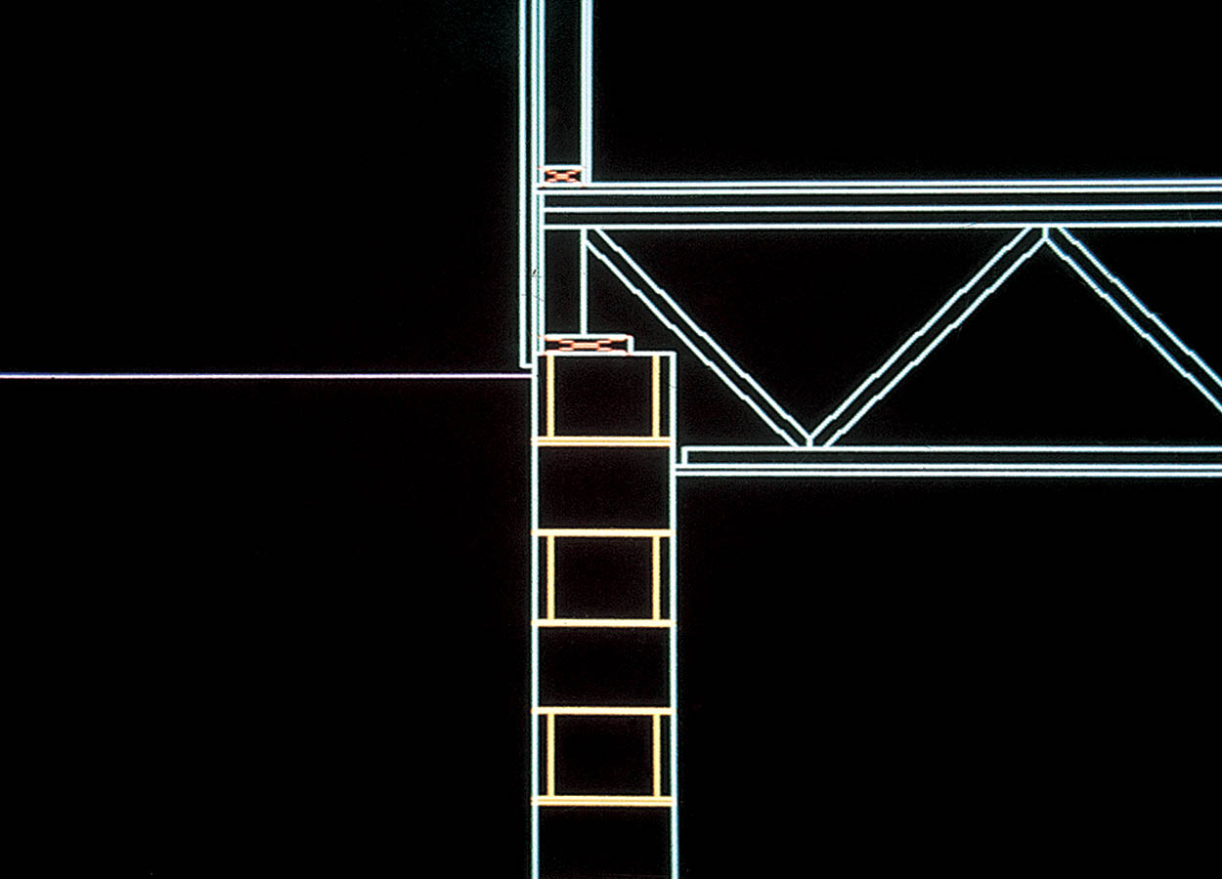
Drawing a Typical Wall Section
Step 3 using CADD.

Slide 19
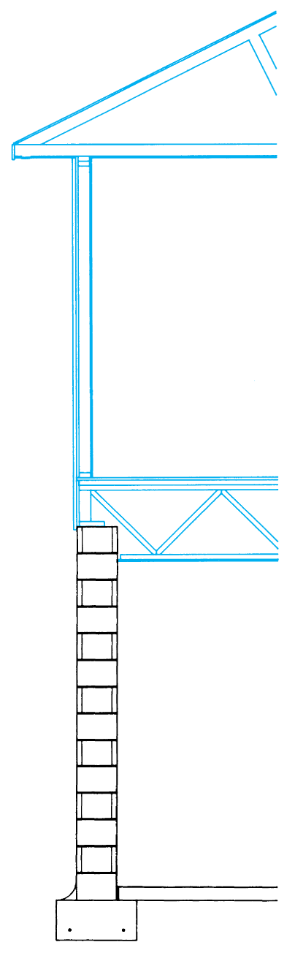
Drawing a Typical Wall Section
Step 3.

Slide 20
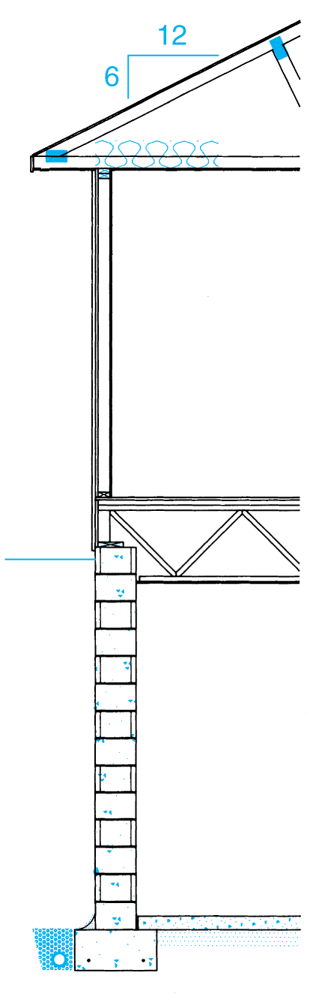
Drawing a Typical Wall Section
Sequential Steps
  4. Add details and material symbols (hatch pattern). Also, draw the grade line, drain tile, and roof slope triangle.

Slide 21
Drawing a Typical Wall Section
Sequential Steps
  5. Add dimensions and notes: Identify grade elevation, use local notes to identify materials, and dimension all vertical heights.
  6. Add the scale and title; look over your work.

Slide 22
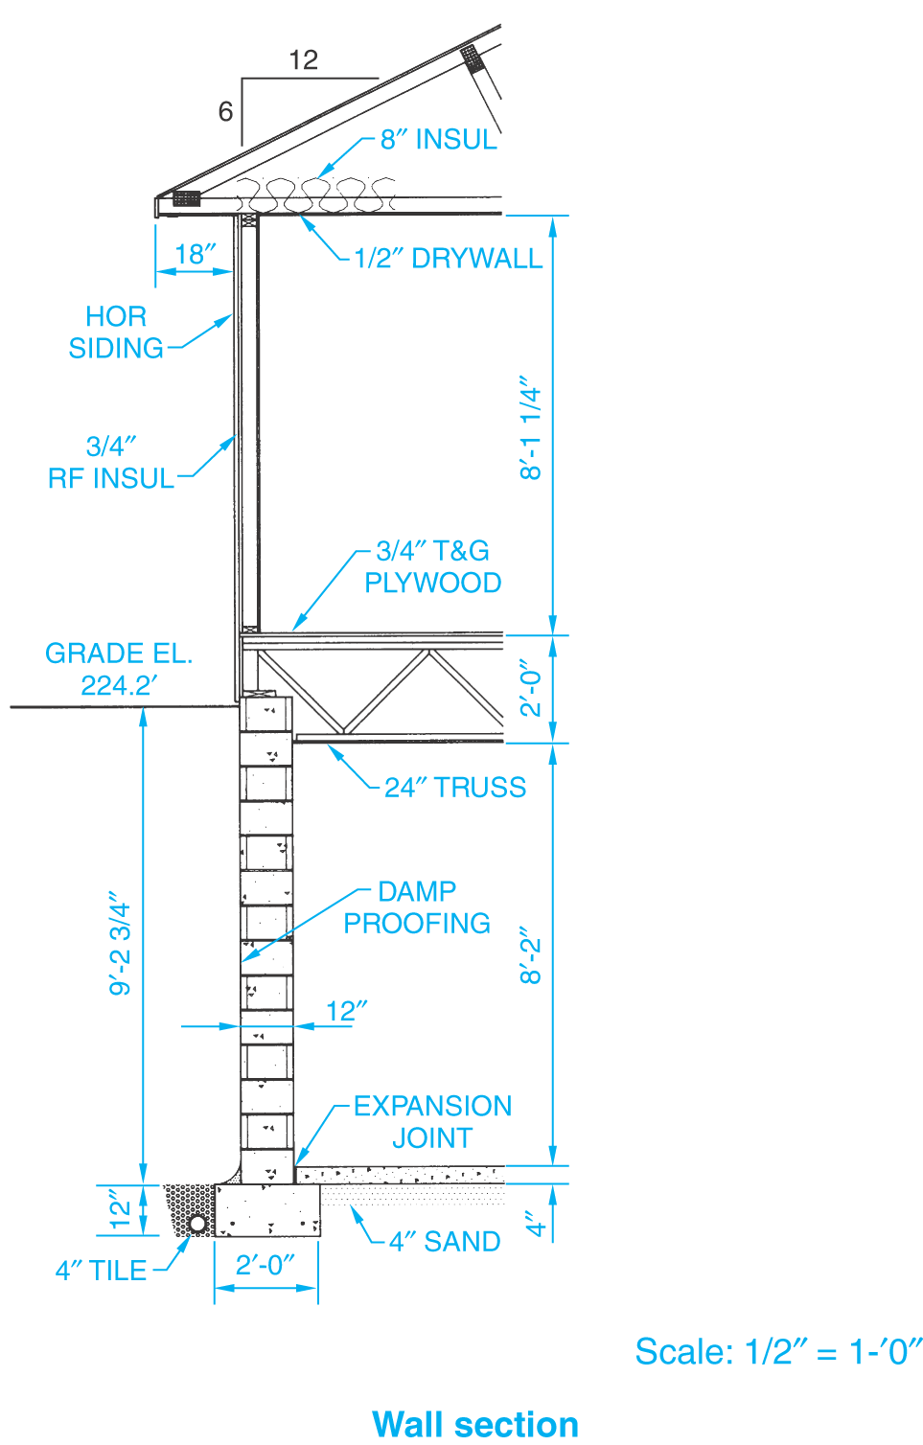
Drawing a Typical Wall Section
Completed wall section.

Slide 23
Drawing an Elevation—Manual
The following procedure will yield fast and accurate results if followed carefully.
Sequential Steps
  1. Draw a section through the wall to be represented by the elevation. Section should be 1/4" = 1'-0" scale. Draw a section for each different type of wall.
  2. Place the floor plan above the space
  where the elevations are to be drawn.

Slide 24
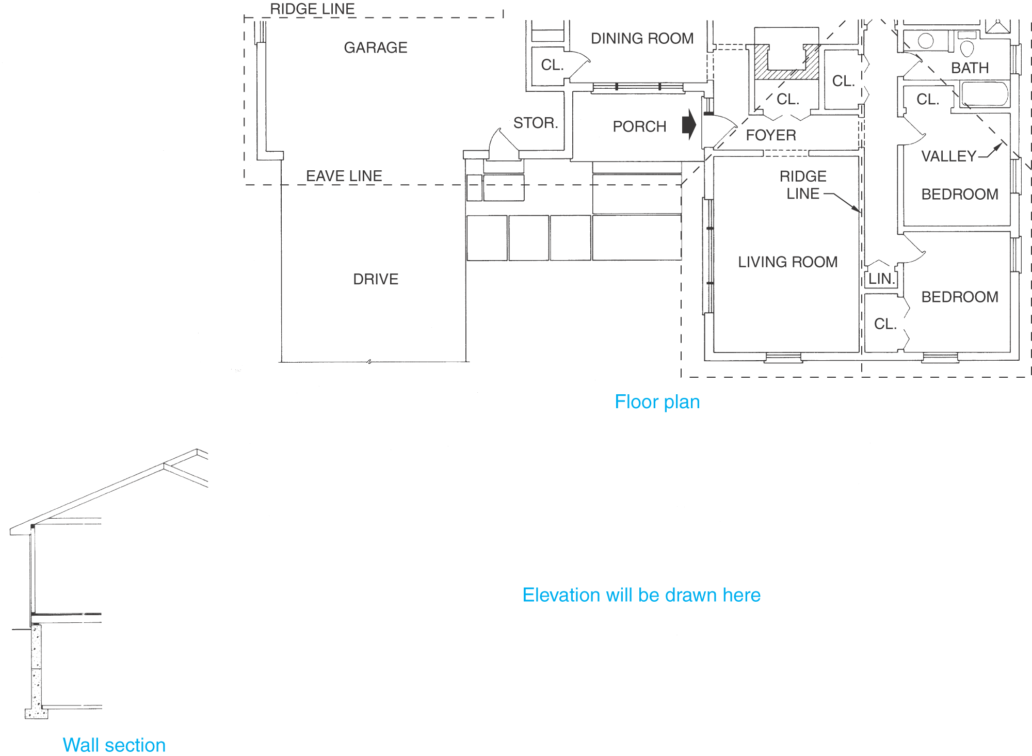
Drawing an Elevation—Manual
Steps 1 and 2.

Slide 25
Drawing an Elevation—Manual
Sequential Steps
  3. Project the heights of the features on the section drawing to the space where the elevation is to be drawn.
  4. Project the features from the floor plan to the space where the elevation is to be drawn.

Slide 26
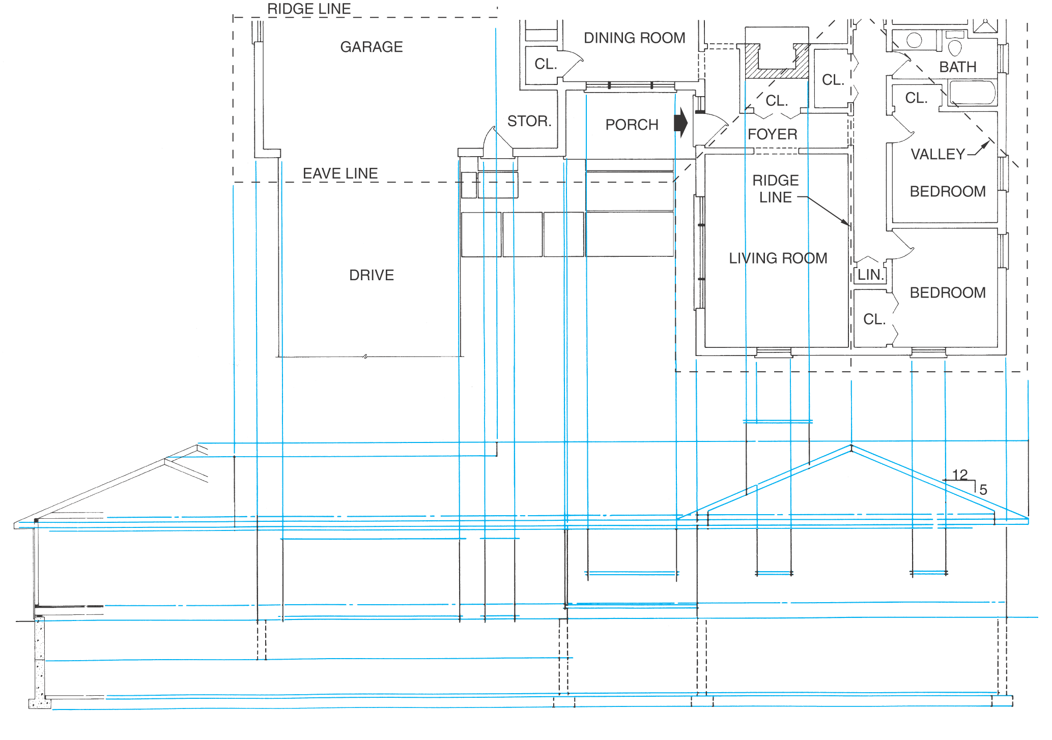
Drawing an Elevation—Manual
Steps 3 and 4.

Slide 27
Drawing an Elevation—Manual
Sequential Steps
  5. Darken each feature and remove the construction lines. Check the overall design now.
  6. Add details such as railings, window muntins, trim, window wells, and gable ventilators. Check manufacturer’s literature.

Slide 28
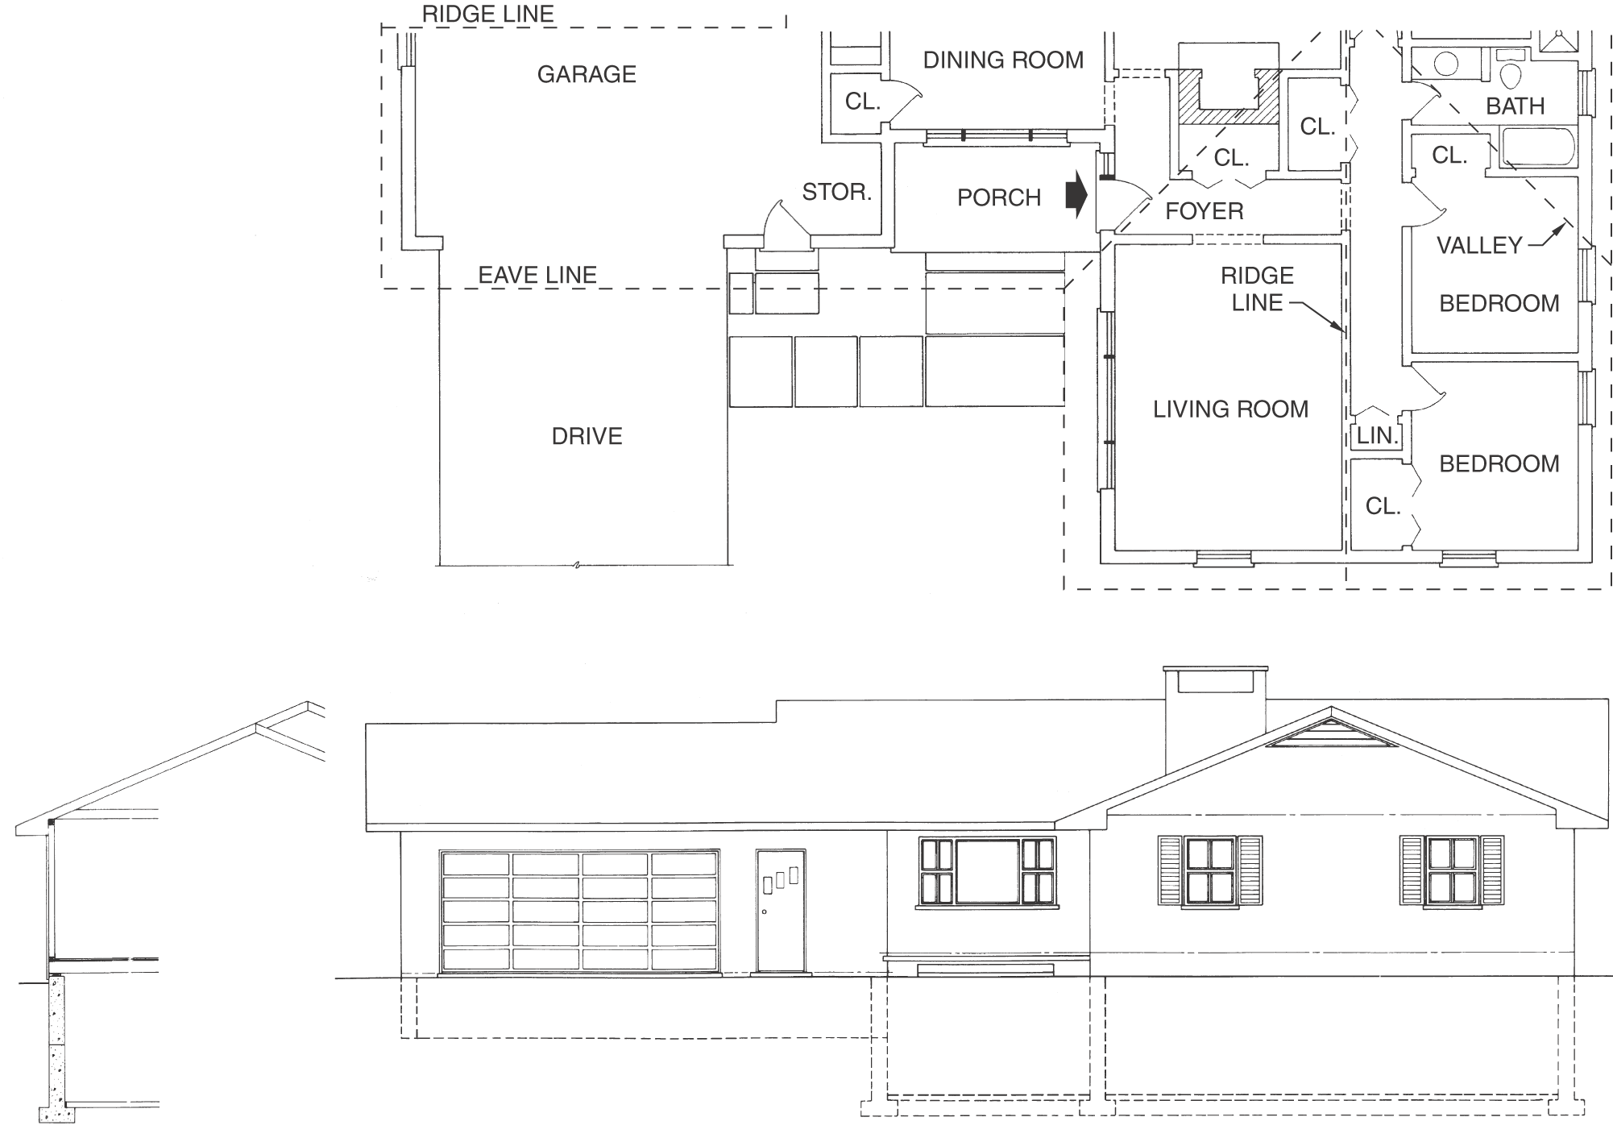
Drawing an Elevation—Manual
Steps 5 and 6.

Slide 29
Drawing an Elevation—Manual
Sequential Steps
  7. Add dimensions, notes, and symbols. Draw material symbols last.
  8. Check the drawing to be sure it is complete.
  9. Add title block and scale.

Slide 30
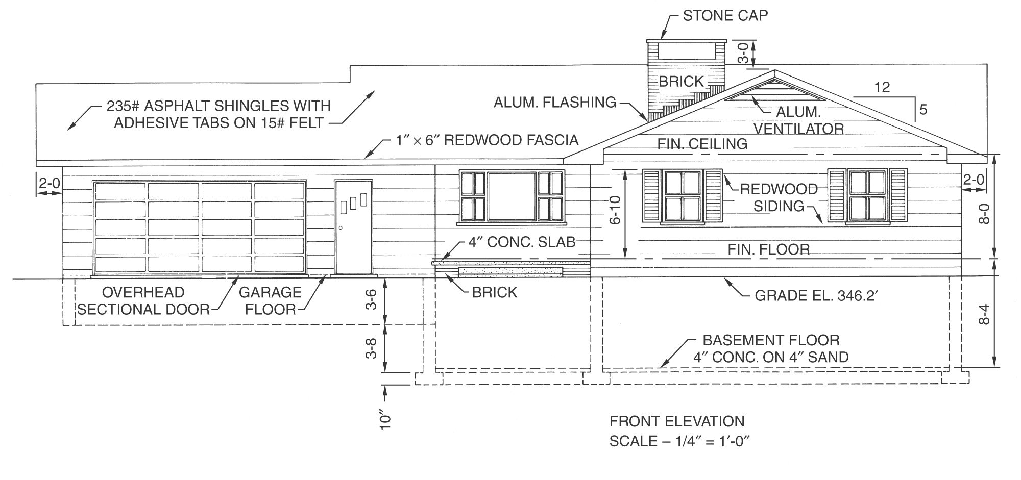
Drawing an Elevation—Manual
Steps 7, 8, and 9.

Slide 31
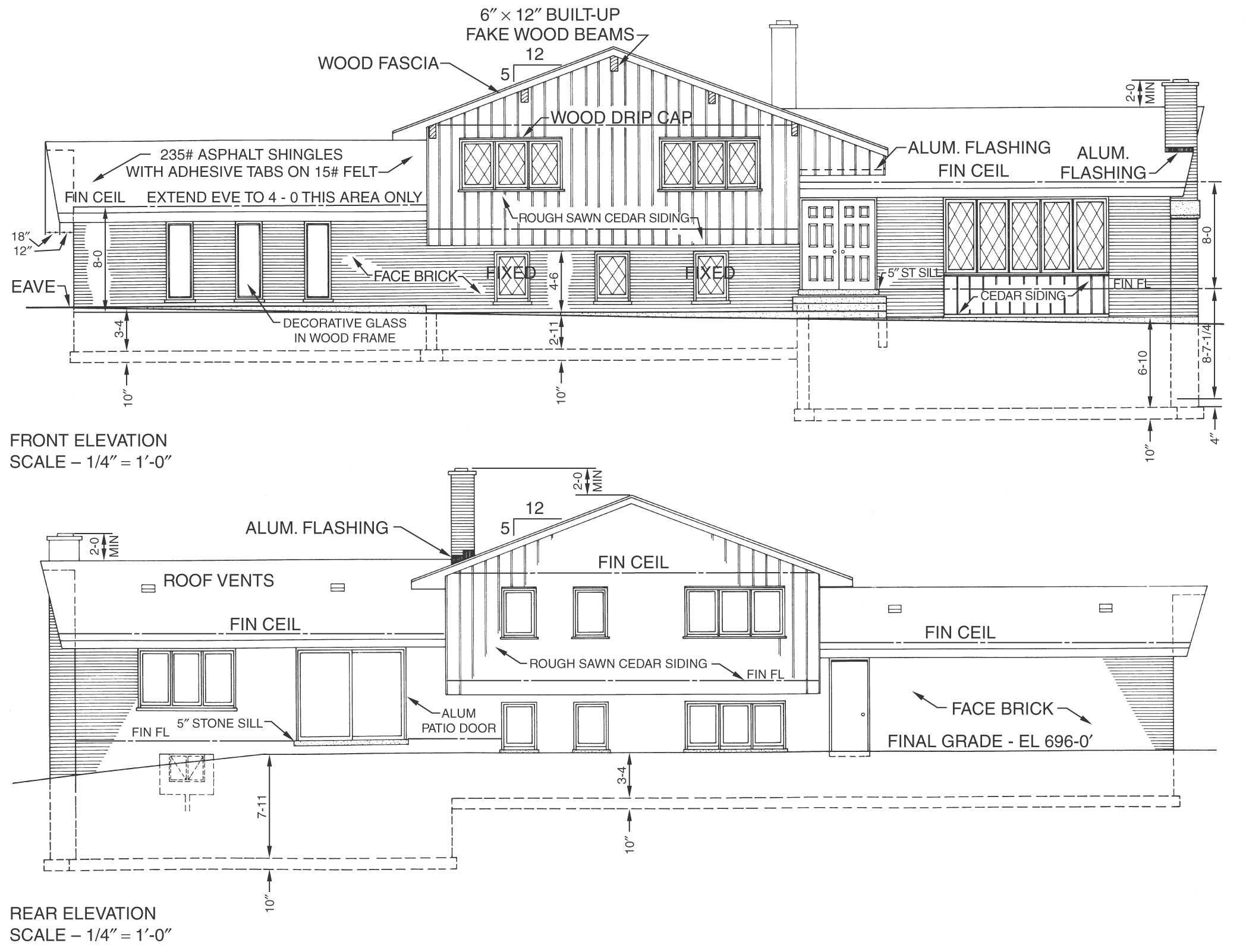
Two Elevations Per Sheet

Slide 32
Drawing an Elevation—CADD
The following steps can be used to draw an elevation using CADD.
Sequential Steps
  1. Draw a typical wall section to provide height measurements. Scale should be 1/4" = 1'-0".

Slide 33
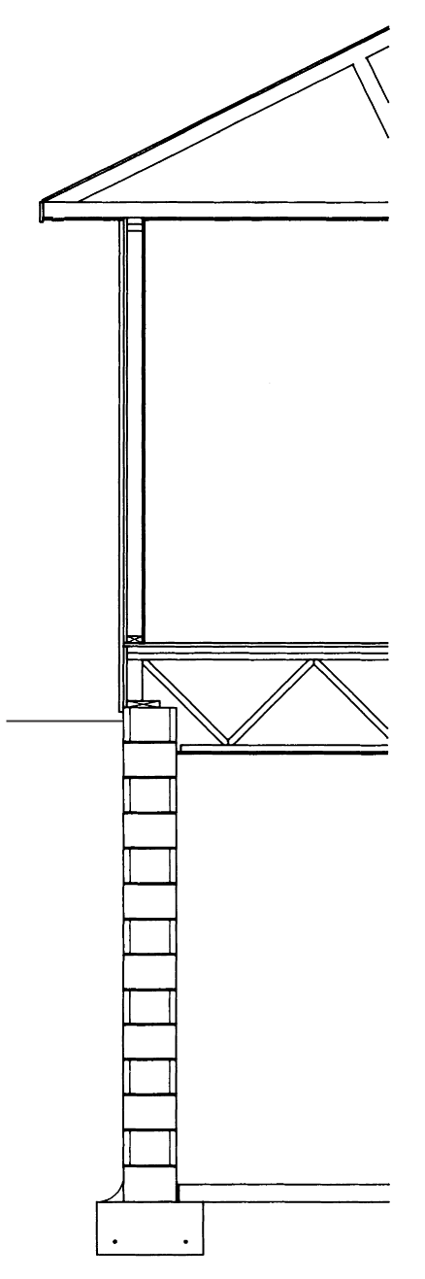
Drawing an Elevation—CADD
Step 1.

Slide 34
Drawing an Elevation—CADD
Sequential Steps
  2. Place a copy of the floor plan above the space where elevation will be drawn. Turn off layers that contain unwanted material.
  3. Project features to be drawn on the elevation from the floor plan. Project one or more elements at a time.

Slide 35
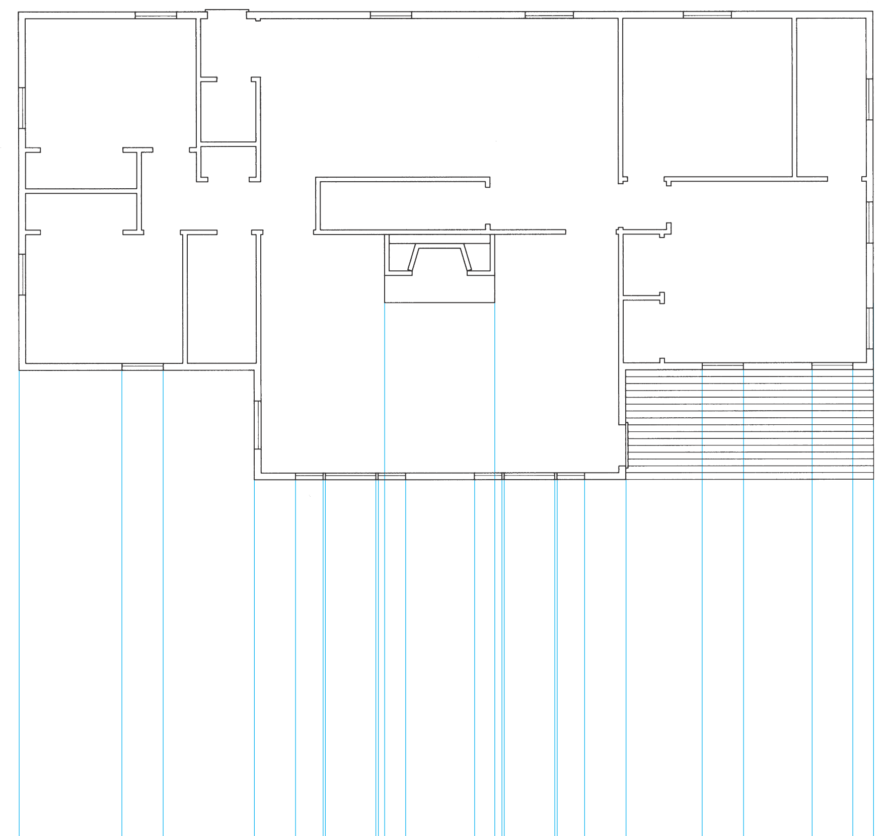
Drawing an Elevation—CADD
Steps 2 and 3.

Slide 36
Drawing an Elevation—CADD
Sequential Steps
  4. Locate the foundation wall, footings, and grade line heights on the elevation. These will be hidden lines except the grade line. Use separate layers.
  5. Locate the wall height and roof lines on the elevation. Use a centerline for floor and ceiling levels.

Slide 37
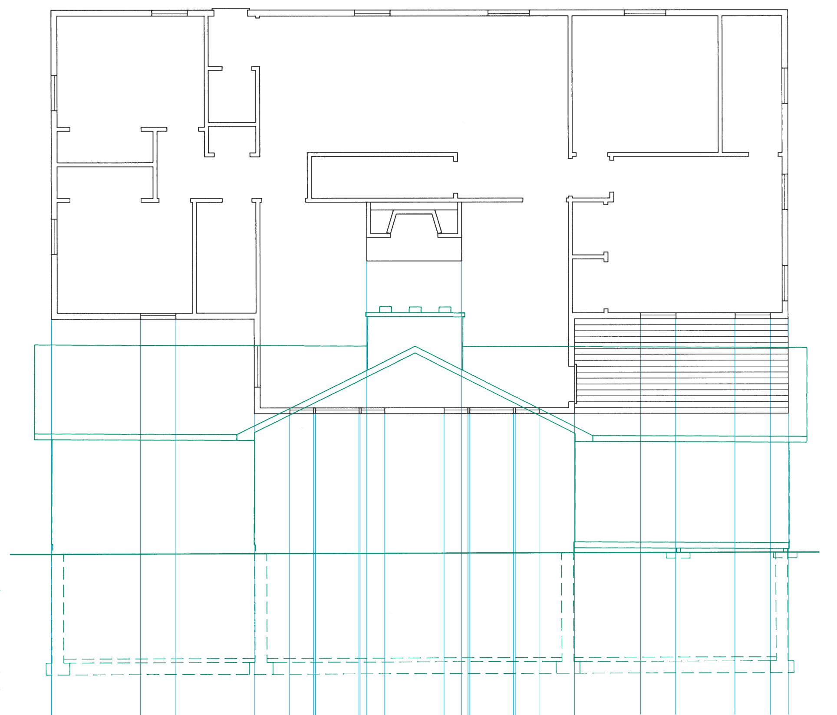
Drawing an Elevation—CADD
Steps 4 and 5.

Slide 38
Drawing an Elevation—CADD
Sequential Steps
  Look at the overall proportions of the house to see if it needs modification.
  6. Locate the height of windows, doors, and any other features. Use the symbols library for complex symbols such as windows. Add all exterior features at this time.

Slide 39
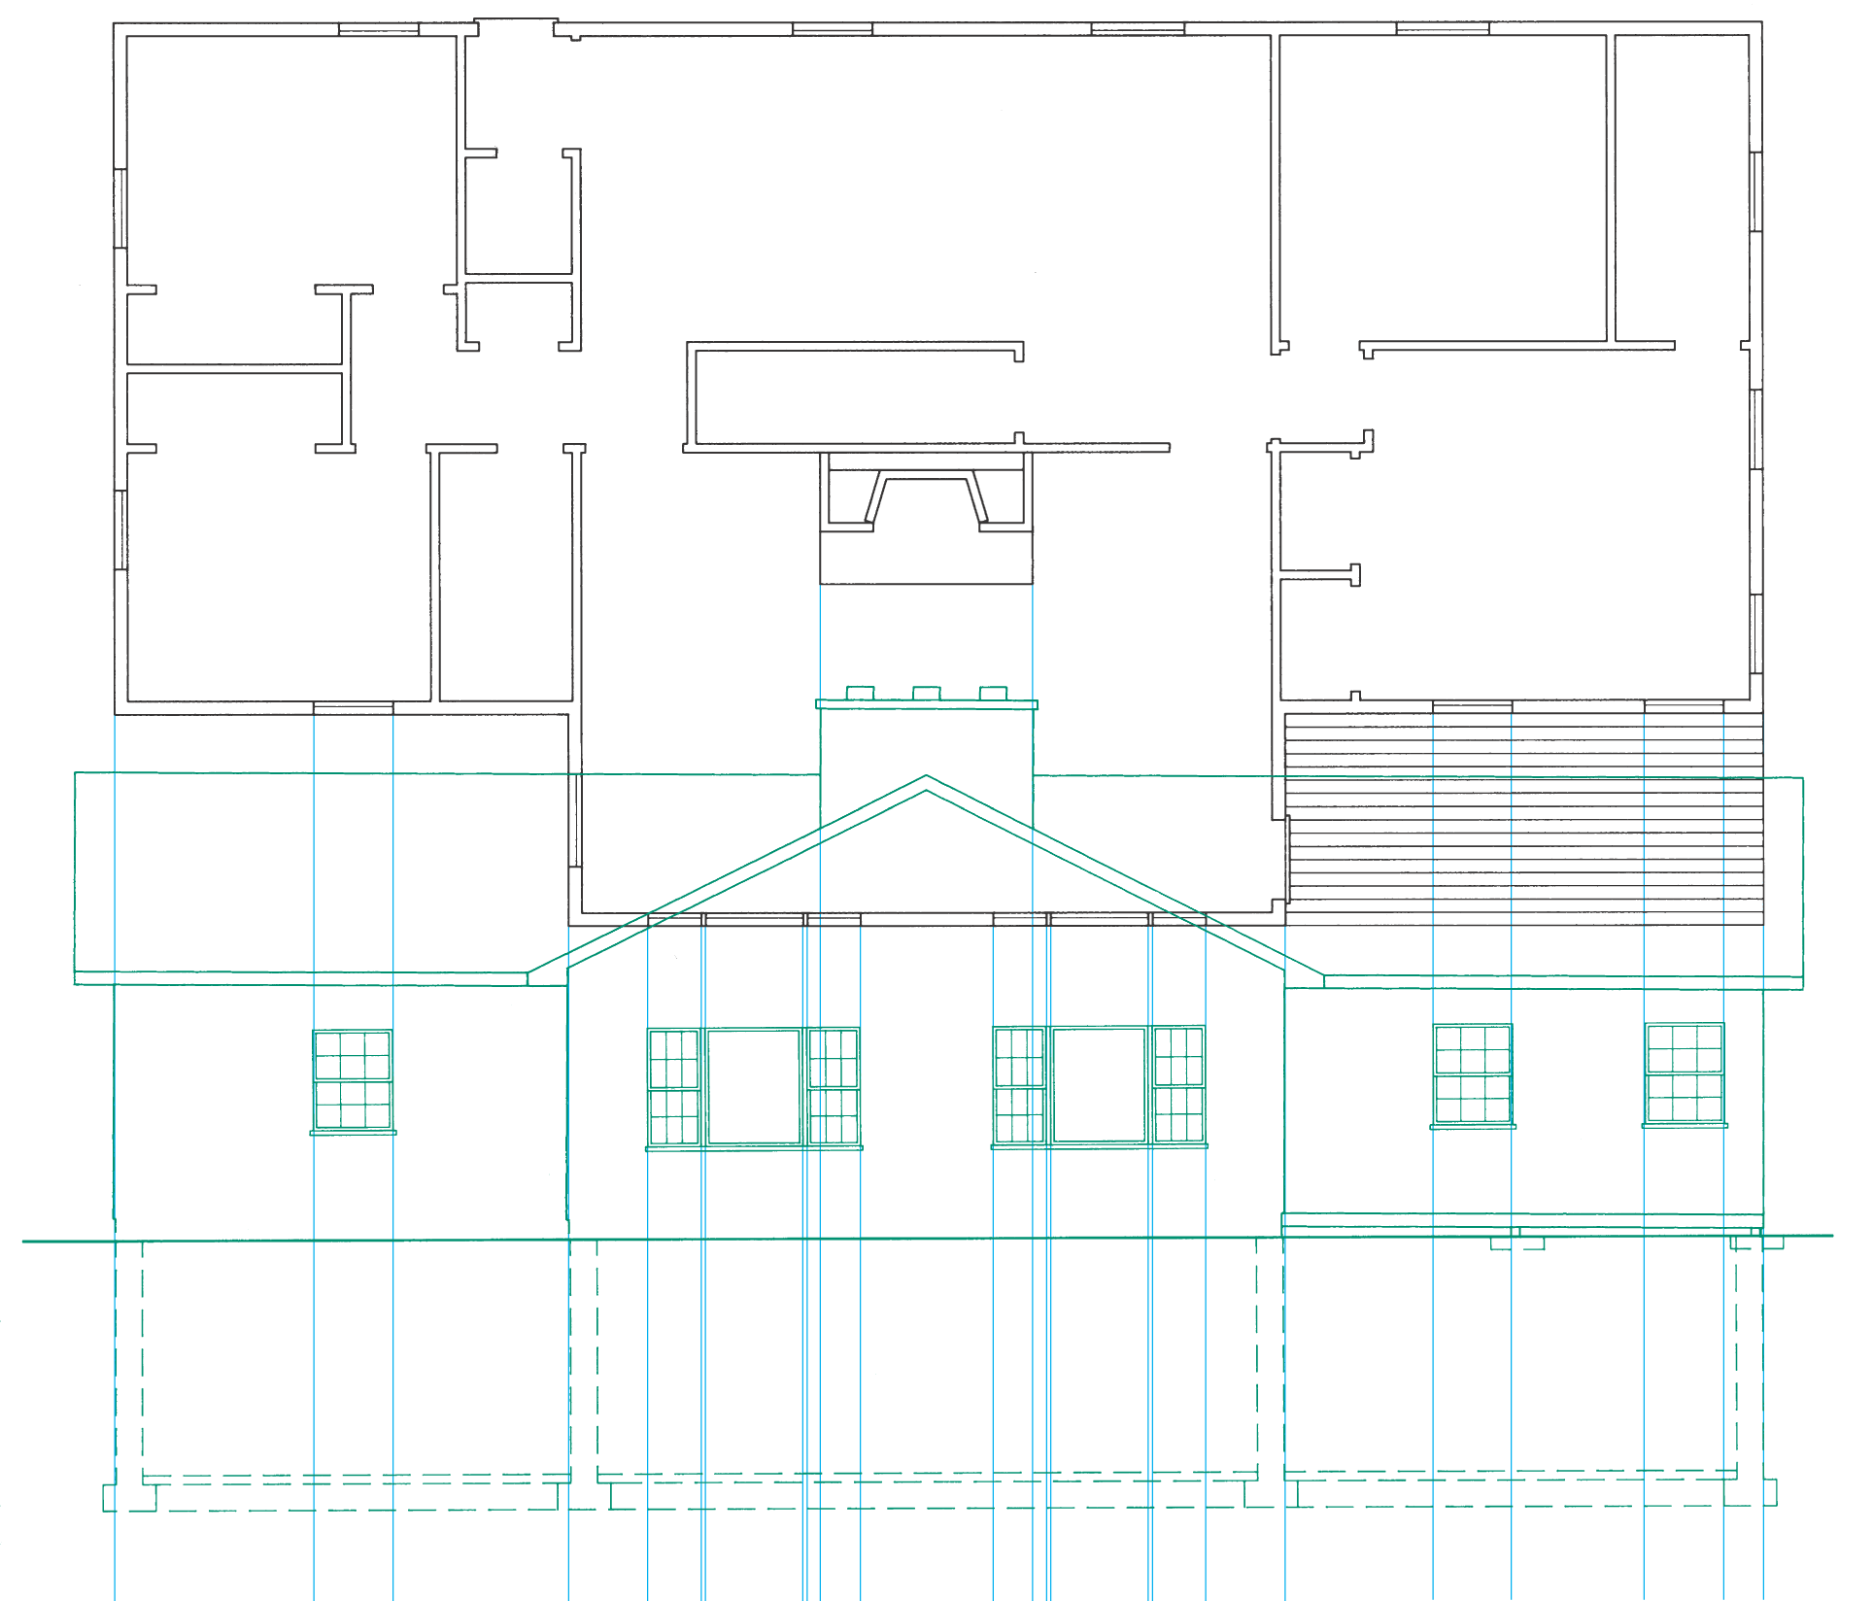
Drawing an Elevation—CADD
Step 6.

Slide 40
Drawing an Elevation—CADD
Sequential Steps
  7. Add dimensions, material symbols, notes, scale, and title. Add notes and dimensions first. Add material symbols next. Add scale and title last. Use separate layers to aid in plotting.

Slide 41
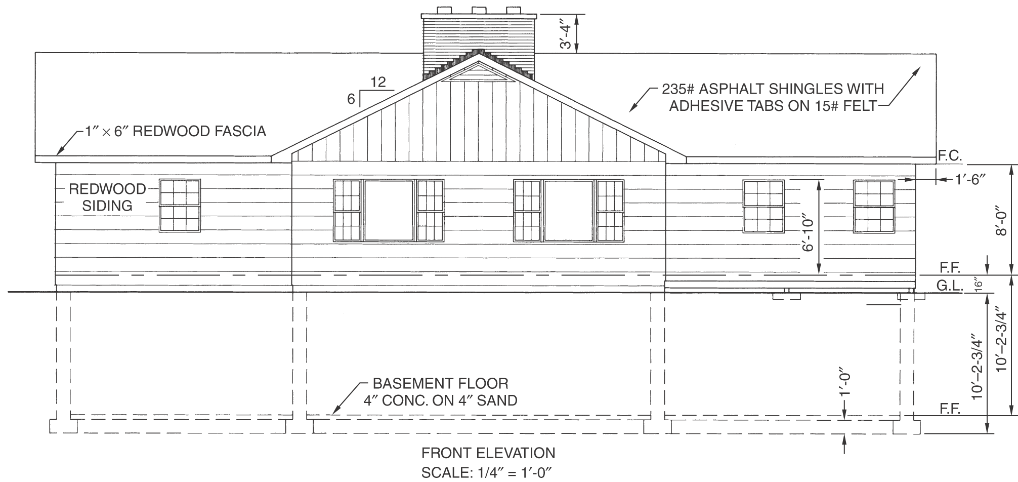
Drawing an Elevation—CADD
Step 7. Completed elevation.

Slide 42
Advanced CADD
Some advanced CADD software can automatically construct elevations using data identified from the floor plan.
3D drawings require X, Y, and Z coordinates for each object to generate any view desired.

Slide 43
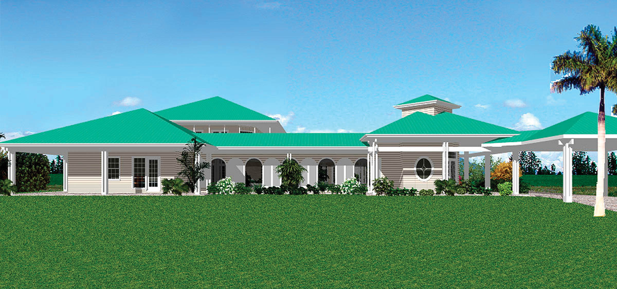
CADD-Generated Elevation
This front elevation was generated from data supplied when the floor plan was developed.

Slide 44
Glossary
Elevation (Drawing).
An orthographic projection drawing that shows one side of a building.
Grade Line.
The spot where the soil surface strikes the building; the reference point for most elevations.
Typical Wall Section.
An orthographic projection where a portion of the wall has been removed to reveal interior detail.

