Slide 1
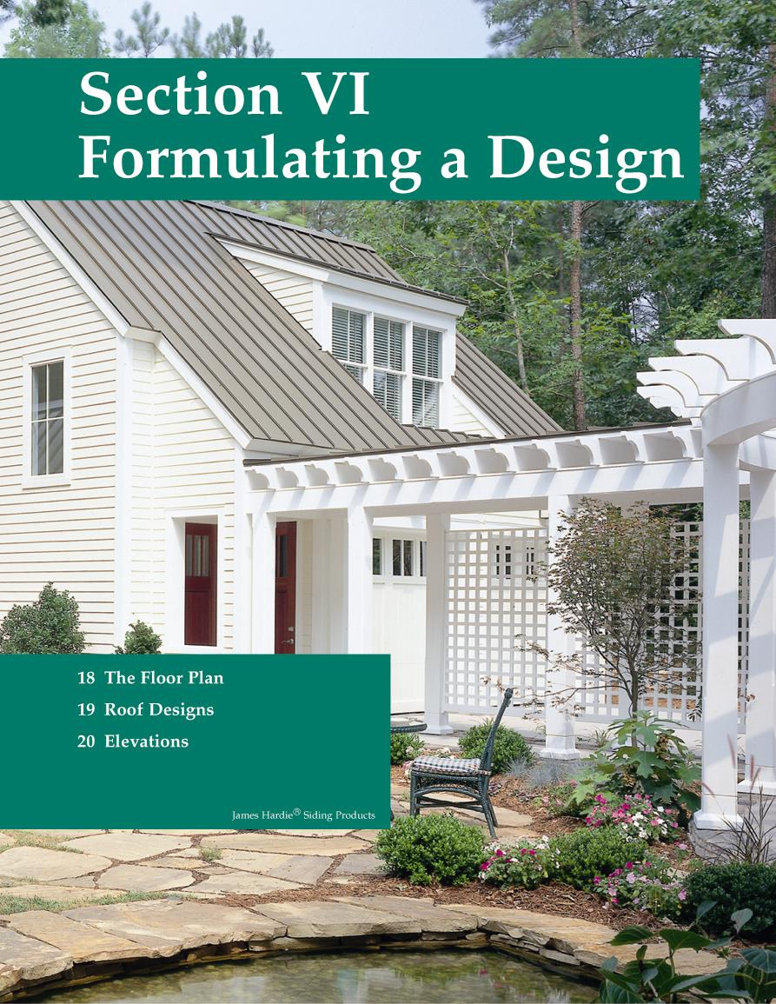
Chapter 16
Roof Designs

Slide 2
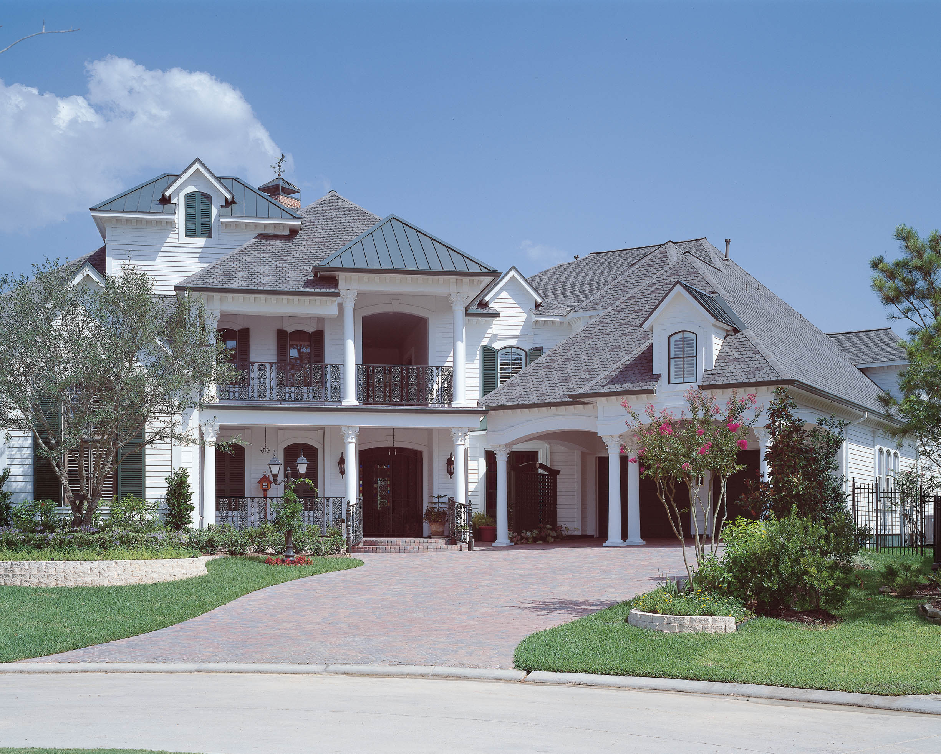
Roof Design
The roof design and roofing materials have a significant impact on the finished appearance of the residence.

Slide 3
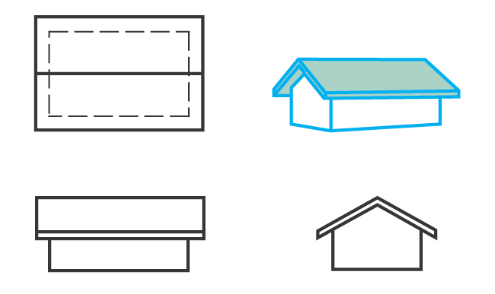
Gable Roof
The gable roof is a very popular type of roof. It is easy to build, sheds water well, provides for ventilation, and can be applied to most house designs.

Slide 4
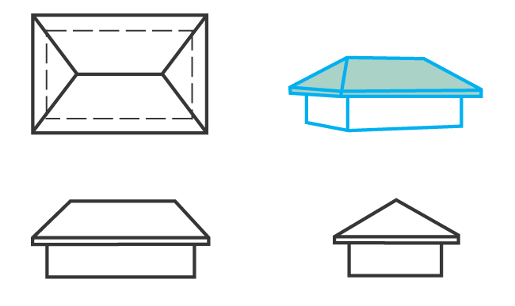
Hip Roof
The hip roof is slightly more difficult to build than a gable roof. It is a popular choice, but does not provide for ventilation as well as some designs.

Slide 5
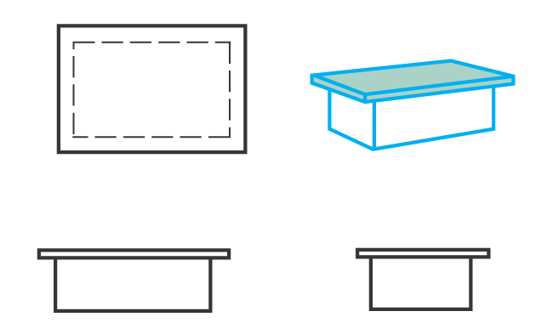
Flat Roof
A flat roof is the most economical roof to build, but it adds little to the design of most houses. It requires a “built-up” or membrane roof covering.

Slide 6
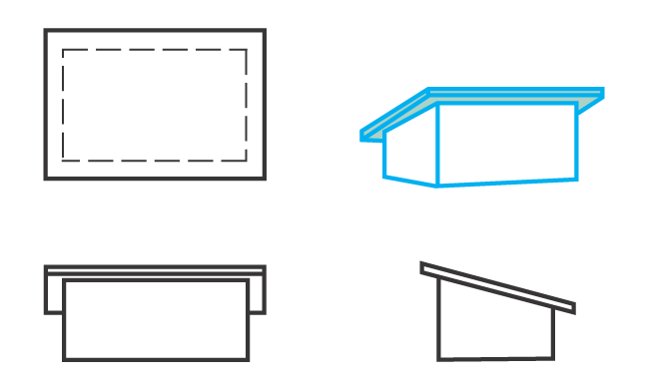
Shed Roof
A shed roof is similar to a flat roof but has more pitch. It is frequently used for additions or with other roof styles.

Slide 7
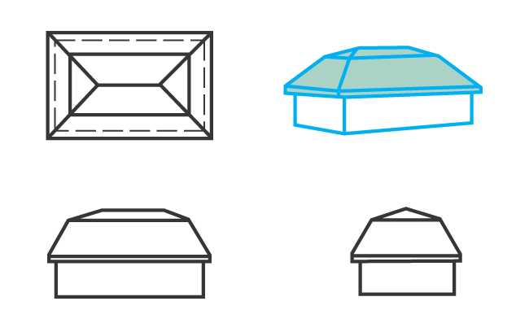
Mansard Roof
The mansard roof is a French design and is more difficult to construct than the hip or gable roof.

Slide 8
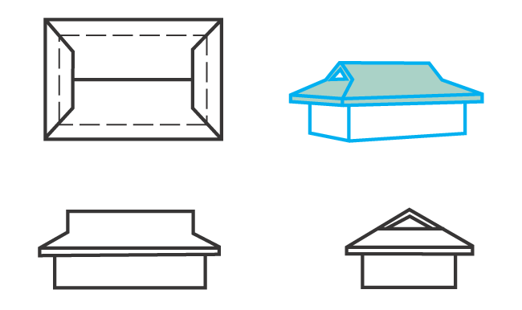
Dutch Hip Roof
The Dutch hip roof is basically a hip roof with a small gable at either end. The gables can be used for ventilation.

Slide 9
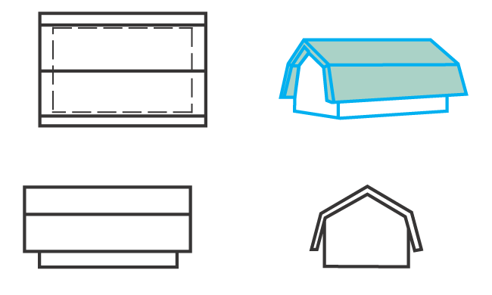
Gambrel Roof
The gambrel roof is sometimes called a barn roof because it has been used extensively on barns. It provides additional headroom in the attic.

Slide 10
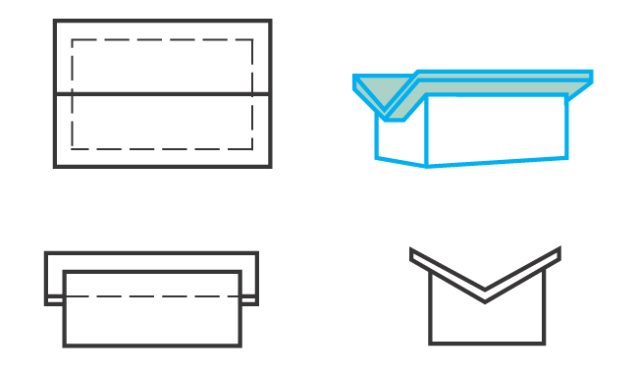
Butterfly Roof
The butterfly roof is not widely used. It provides plenty of light and ventilation, but drainage is a problem.

Slide 11
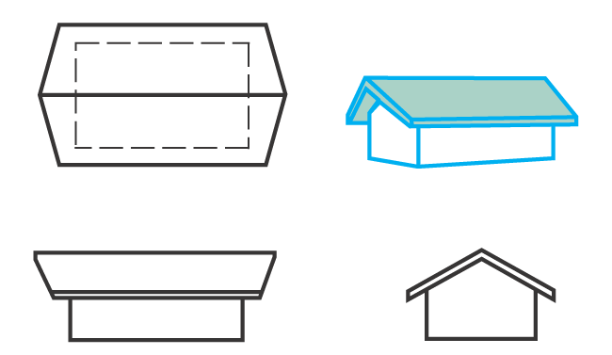
Winged Gable
The winged gable is essentially a gable roof, extended at the peak.

Slide 12
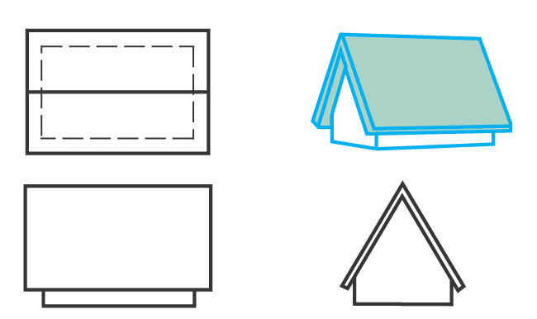
A-Frame Roof
The A-frame roof provides a roof and walls for the structure. Is popular for cottages, homes, churches, and other structures.

Slide 13
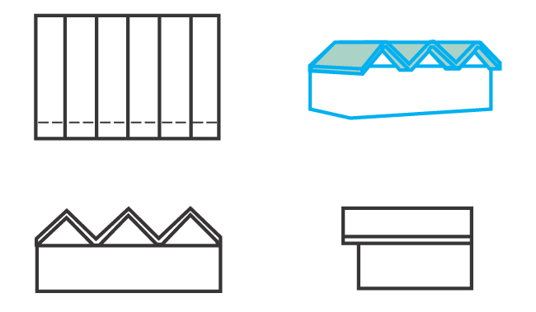
Folded Plate Roof
The folded plate roof has limited use in single-family homes. Modular, prefabricated roof units are available.

Slide 14
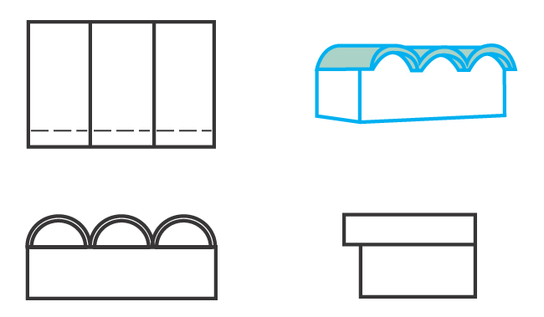
Curved Panel Roof
The curved panel roof is similar to the folded plate roof in style and application. It is available in prefabricated modules.

Slide 15
Contemporary Roof Types
Several roof types that fit this category include the following.
  Parasol roof: Looks like an upturned parasol or umbrella; usually concrete.
  Warped roof: Most common shape is a hyperbolic paraboloid made from concrete, plywood, or plastic.
  Free-form roof: May take any shape that can be formed by stretching a fabric over a support frame and then sprayed with foam.

Slide 16
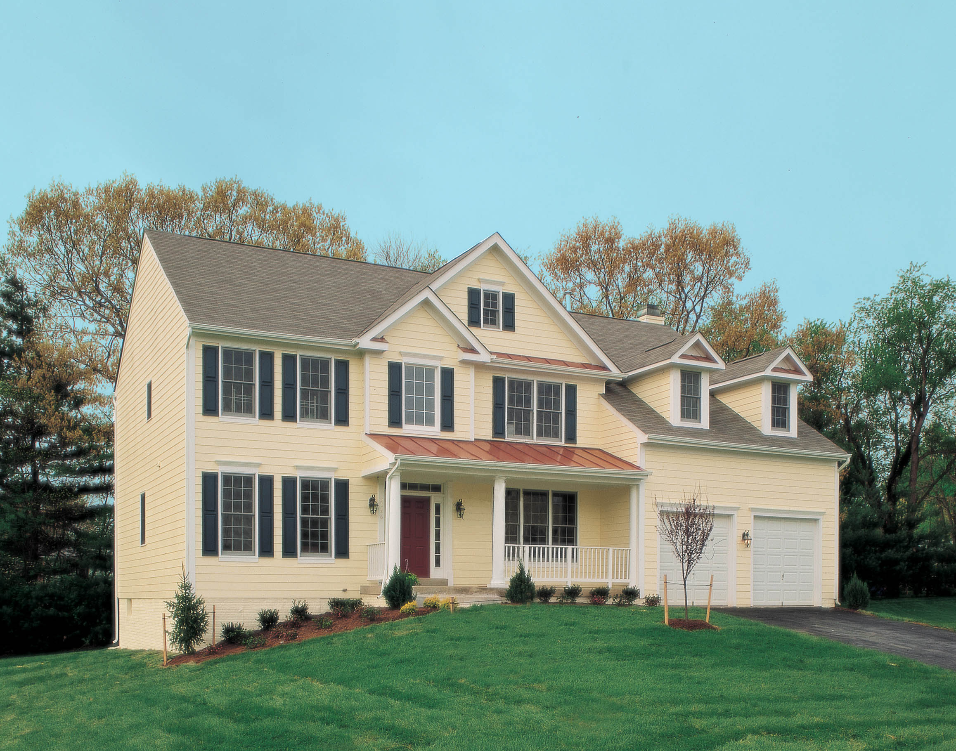
Mixed Roof Styles

Slide 17
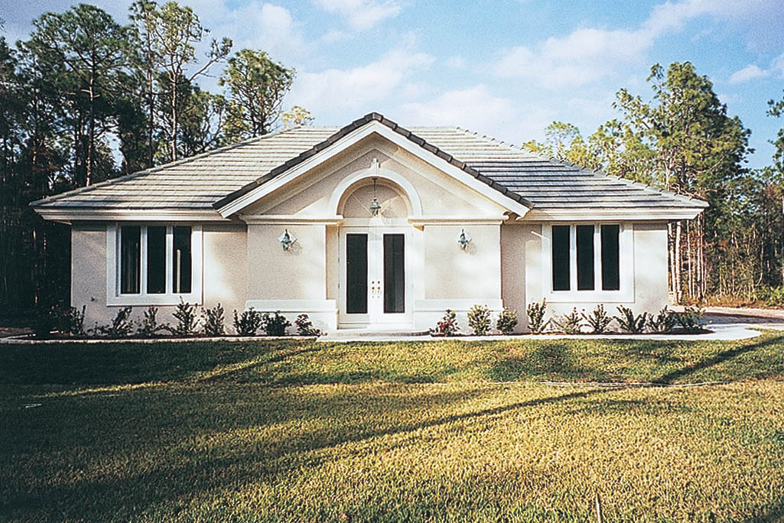
Mixed Roof Styles

Slide 18
Frame Roof Construction
Several features of traditional frame roof construction should be considered before designing a roof.
The roof framing is designed to support the roof covering materials.
Framing must be strong and rigid.
Roof framing consists of several distinct structural elements.

Slide 19
Rafters
The rafter is a structural element of the roof that supports the sheathing.
Common rafters are perpendicular to the wall plate and extend from the ridge.
There are several other types of rafters used in typical construction.
Rafters are often shown on a roof framing plan.

Slide 20
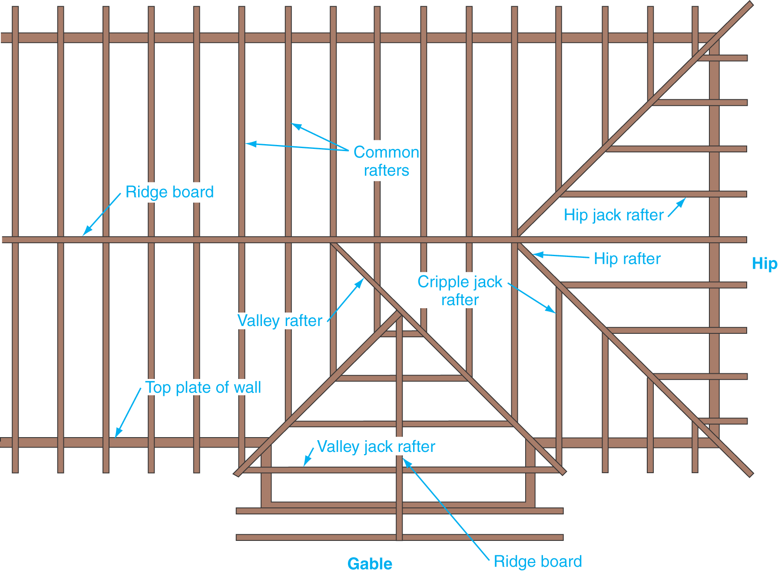
Roof Framing Plan
Roof framing plan with structural members identified.

Slide 21
Rafters
Rafters are cut to the proper lengths by locating the ridge, seat, plumb, and tail cuts.
The slope of the roof and the clear span of the building determine the layout of these cuts.
You must know these terms: rise, run, clear span.

Slide 22
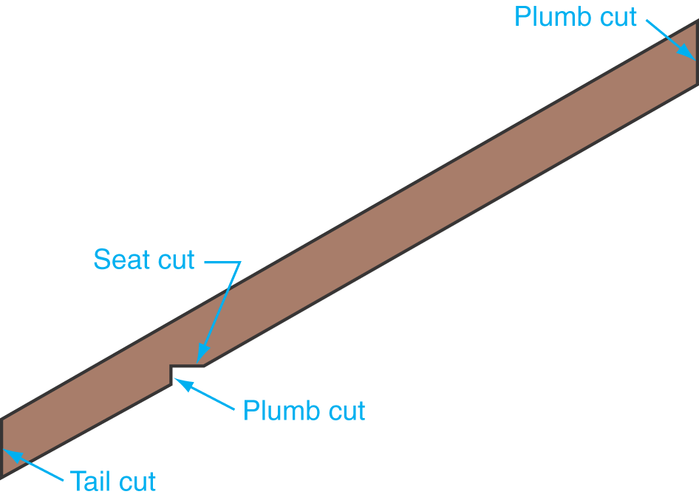
Common Rafter
A common rafter with the cuts labeled.

Slide 23
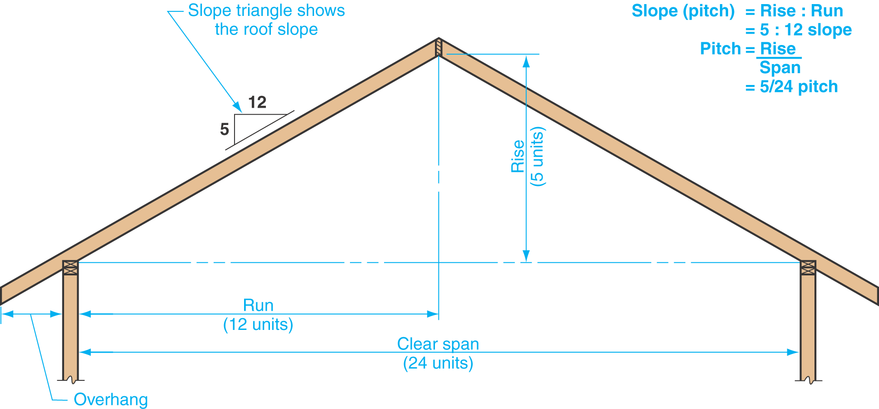
Roof Terms
Illustration of roof rise, run, and span.

Slide 24
Roof Slope
Roof slope is the slant of the roof.
Shown on a drawing as a slope ratio diagram or fractional pitch.
The slope diagram represents the ratio between the rise and run of the roof.
The run is always expressed as 12 units.
Fractional pitch is rise/clear span.

Slide 25
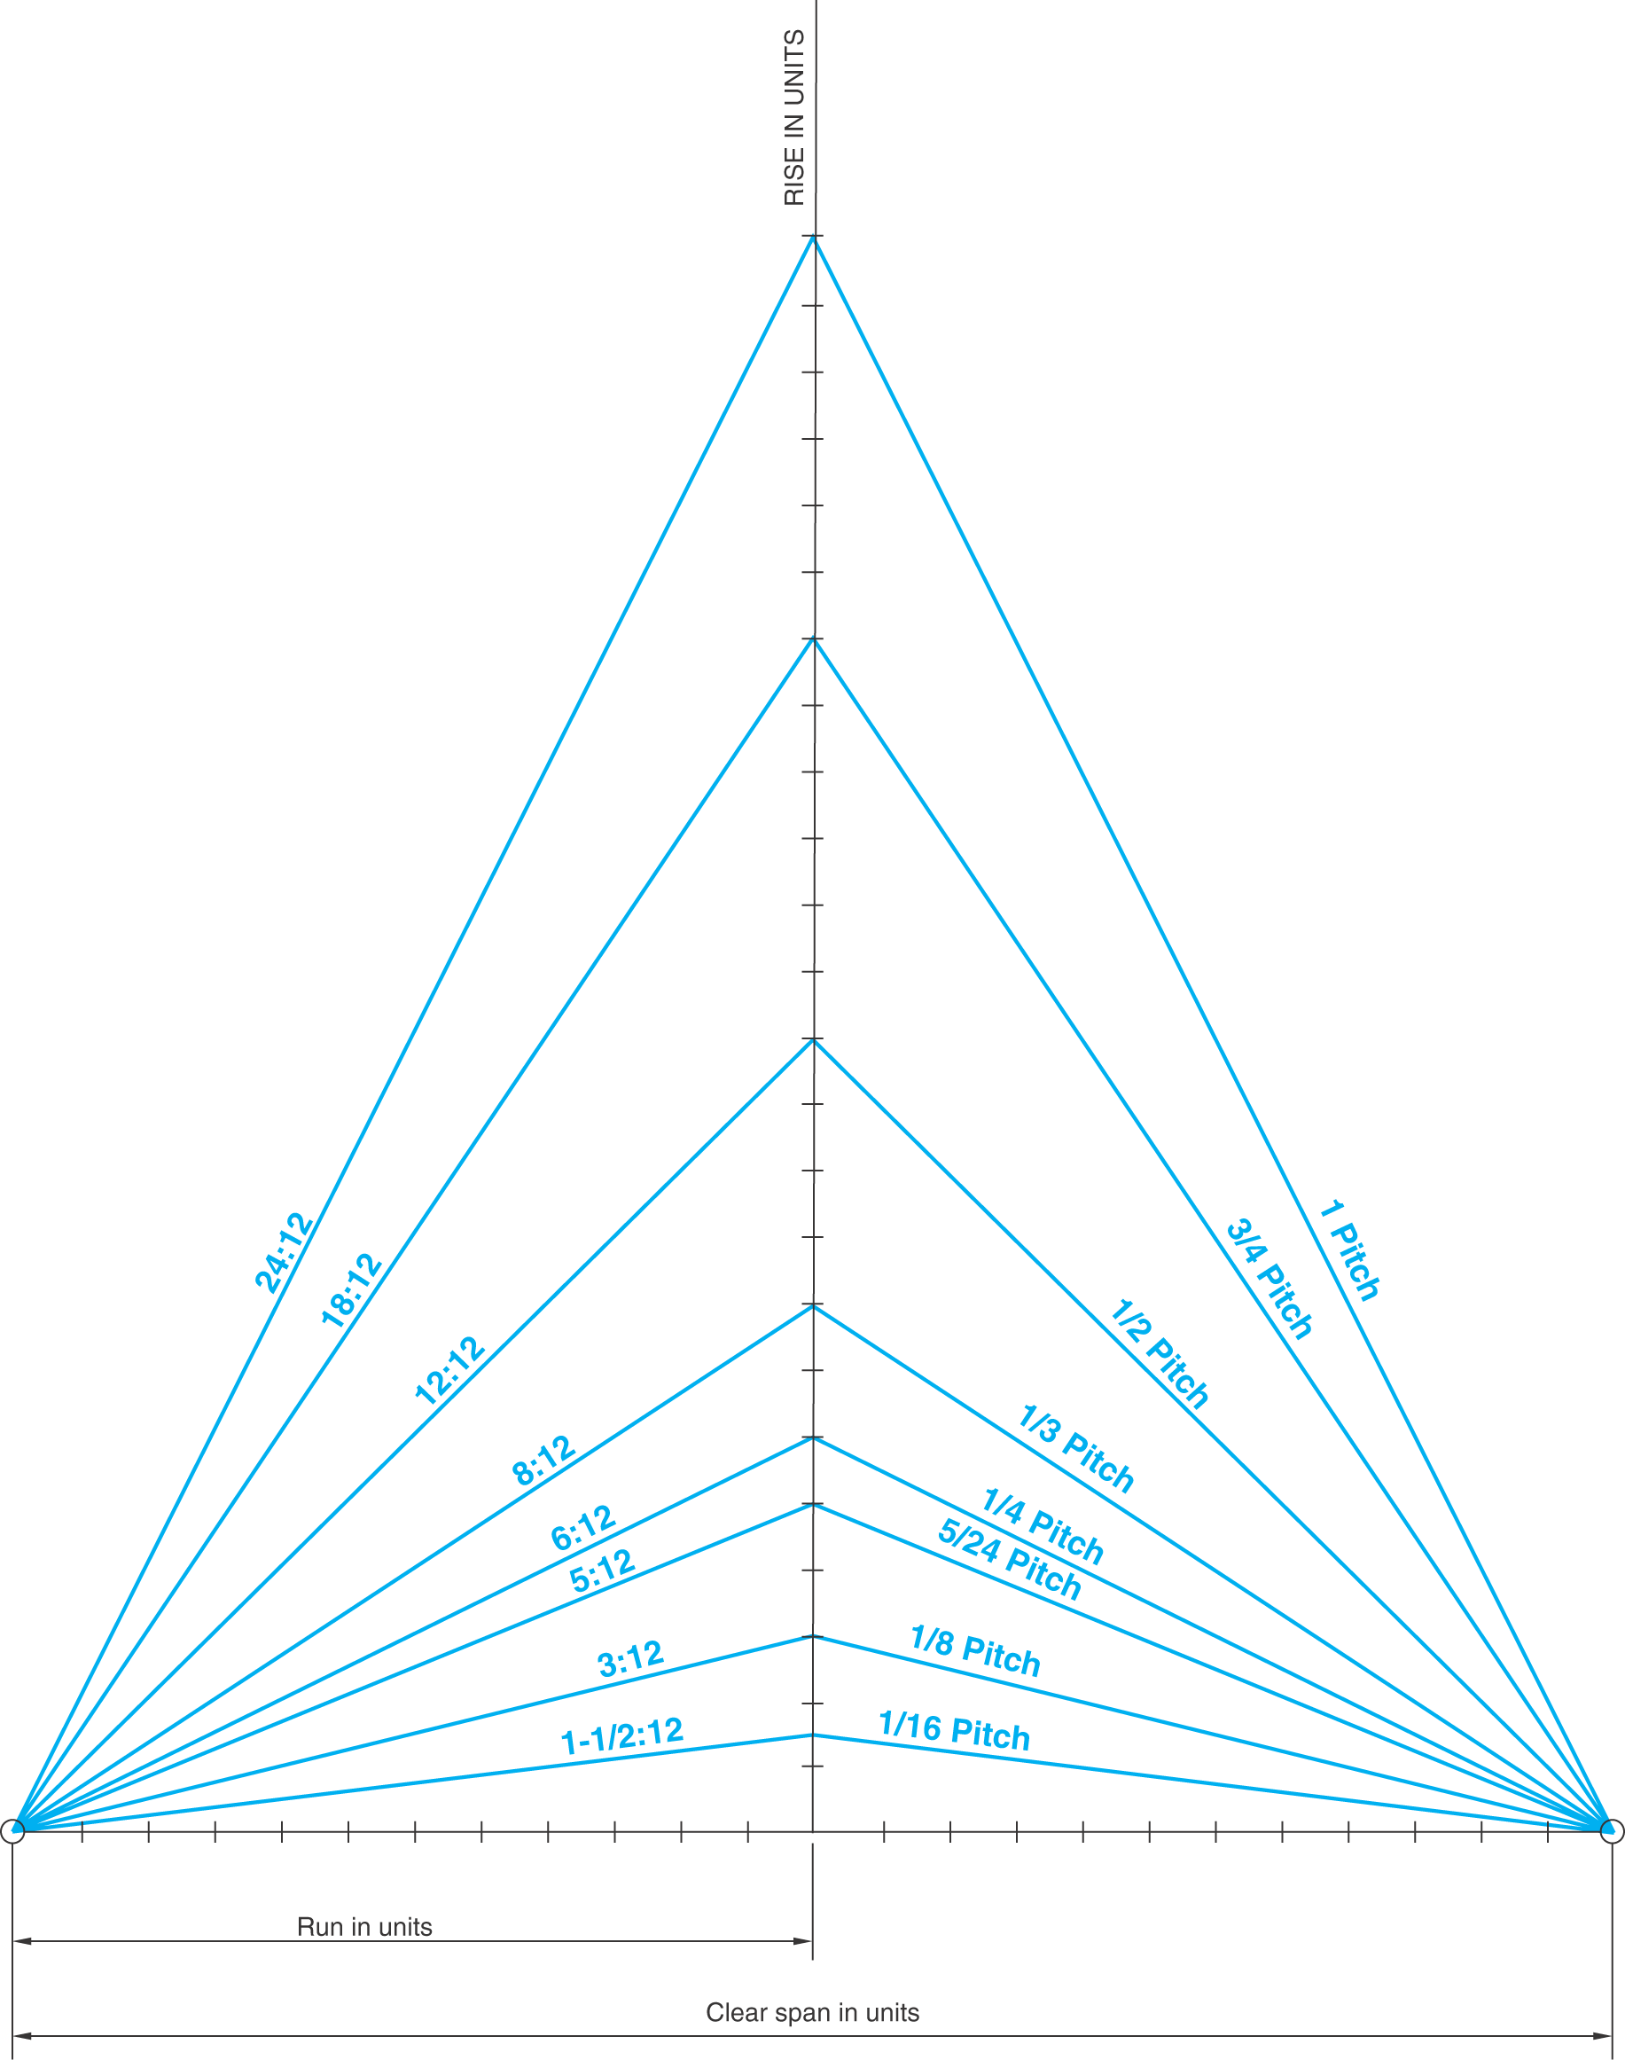
Roof Pitches
Several roof pitches (slopes) used in residential construction.

Slide 26
Rafter Sizes
Rafter sizes depend on the distance to be spanned, spacing of the rafters, and weight to be supported.
Rafters may serve as ceiling joists on low-sloped roofs.
See Figure 19-8 in the text for rafter span data.

Slide 27
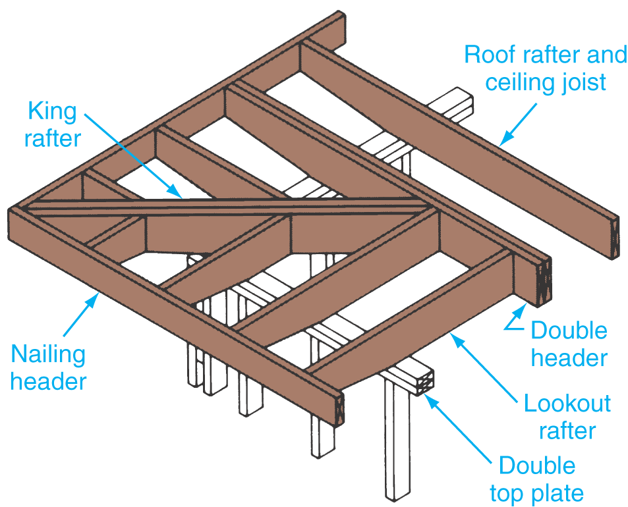
Rafters for a Flat Roof
Framing detail of the cornice for a flat or low-pitched roof.
Rafters serve as ceiling joists in this design.

Slide 28
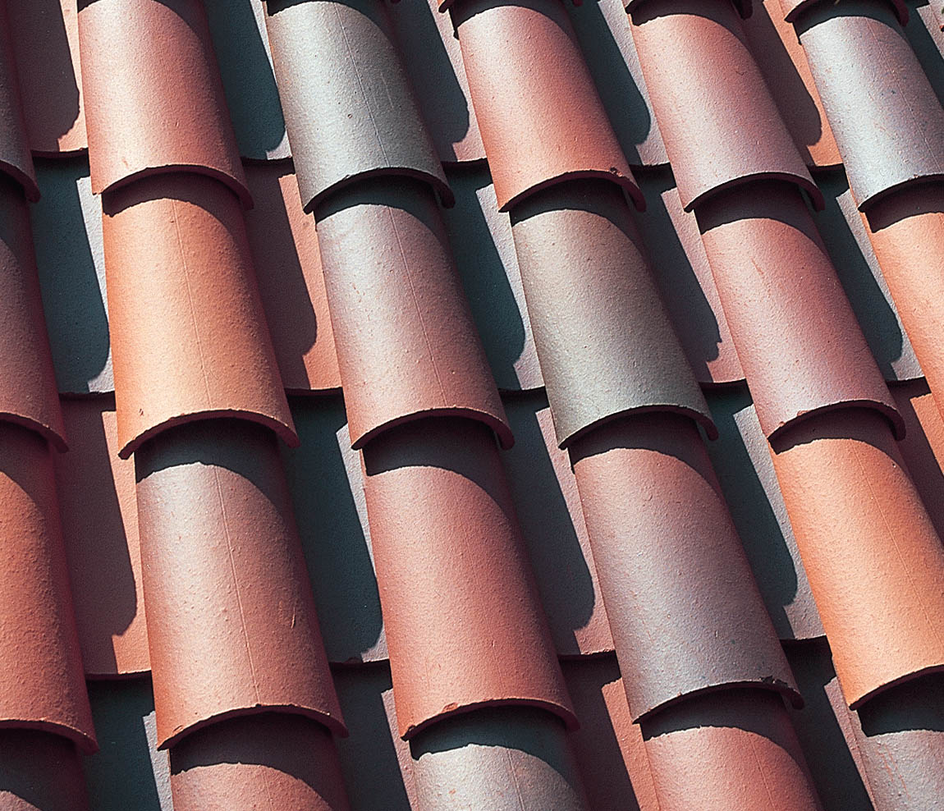
Heavy Roofing
A roofing material that weighs more than 4 pounds per square foot is considered a heavy roofing material.
Slate and clay tile are examples.

Slide 29
Cornice
The cornice is that part of the roof that overhangs the side walls.
Three types of cornices are frequently used in residential construction.
  Open cornice.
  Box cornice.
  Close cornice.

Slide 30
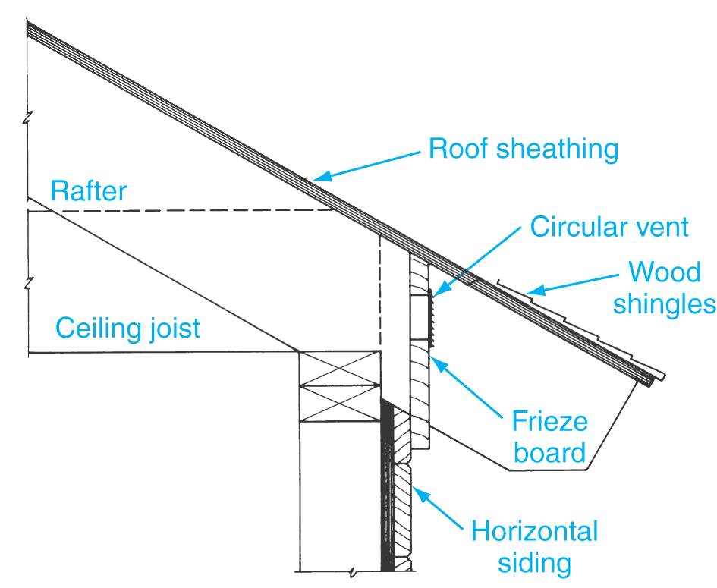
Cornice
The open cornice may be used with exposed-beam construction.
Rafter ends are exposed with a decorative cut.

Slide 31
Cornice
When the space between the ends of the projecting rafters and the wall is enclosed with a soffit board, a box cornice results.
There are three basic types of box cornices.
  Narrow box, wide box with lookouts, and wide box without lookouts.

Slide 32
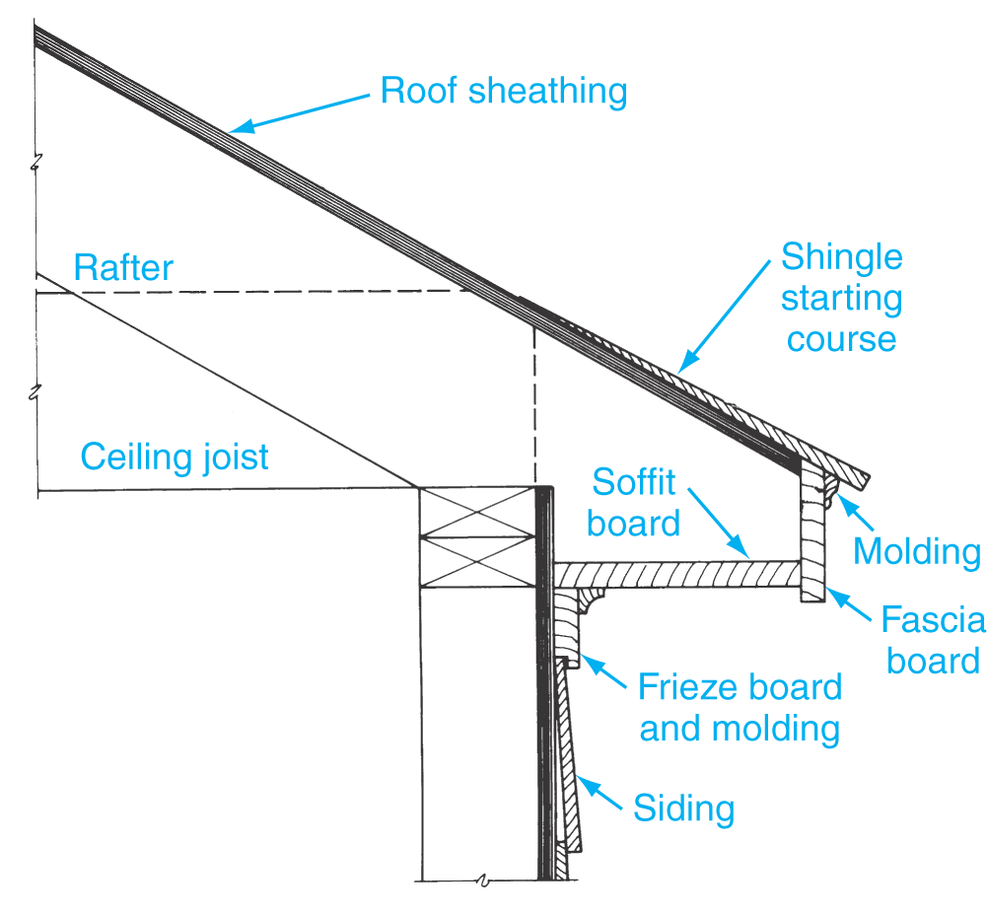
Cornice
A narrow box cornice is generally between 6" and 12" wide.
The soffit board is nailed directly to the bottom side of the rafters.

Slide 33
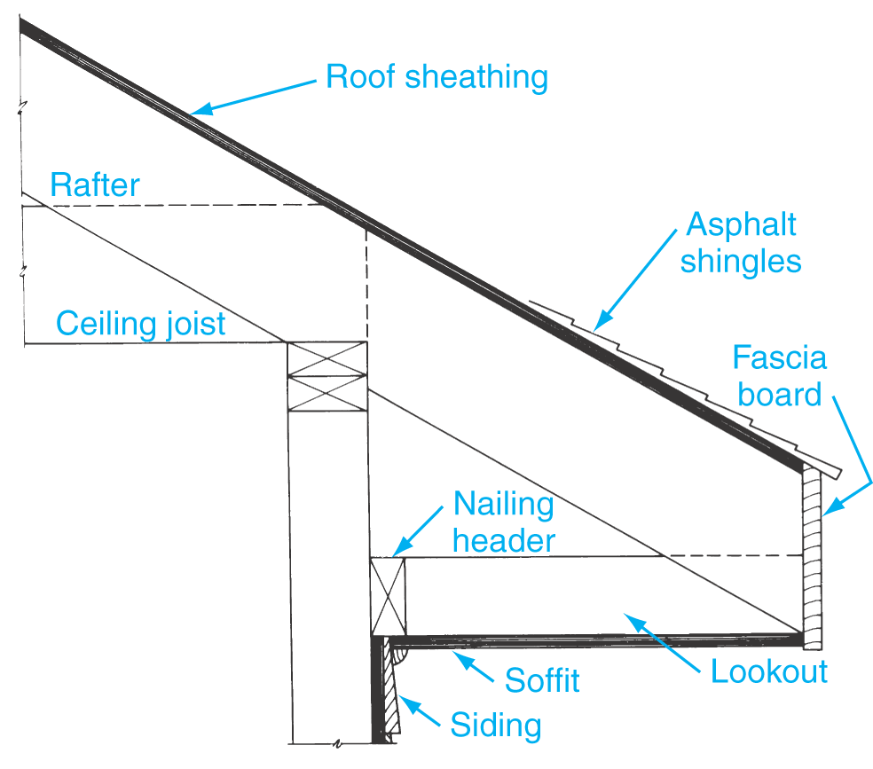
Cornice
A wide box cornice with lookouts normally requires additional support members called lookouts for fastening the soffit.

Slide 34
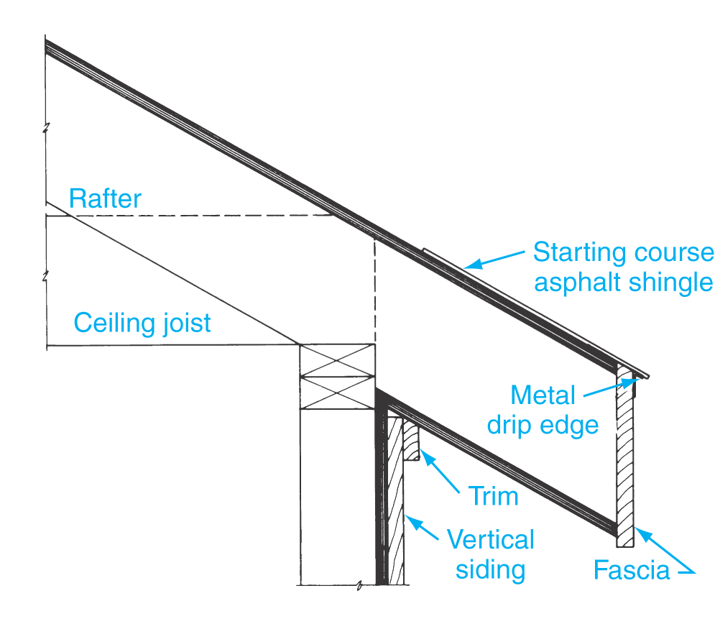
Cornice
A wide box cornice without lookouts has a sloped soffit.
The soffit material is nailed to the underside of the rafters.

Slide 35
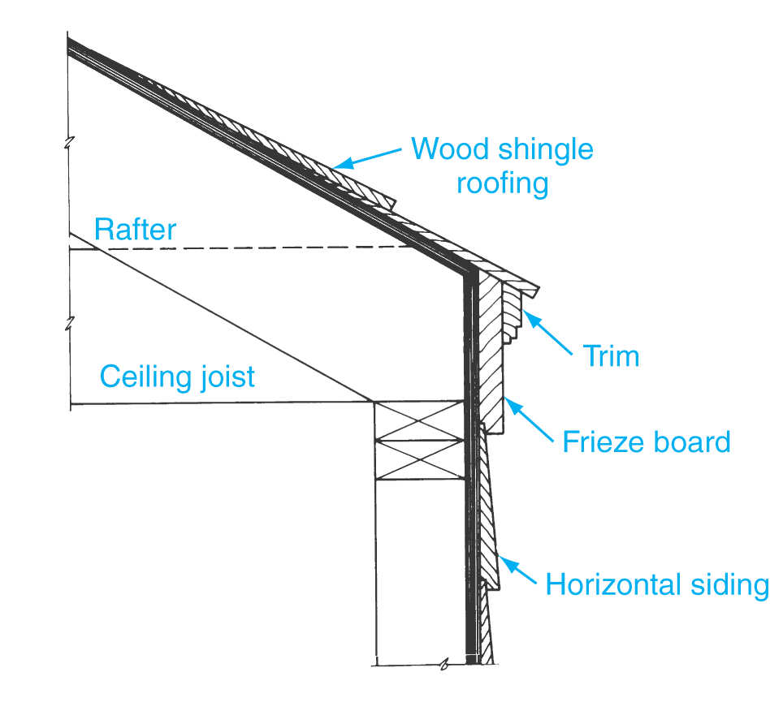
Cornice
A close cornice is one where the rafter does not project beyond the wall.
The roof is terminated by a frieze board and molding.

Slide 36
Gable End (Rake)
The gable end, or rake, is an extension of a gable roof beyond the end wall of the house.
Proportions should be similar to other parts of the roof.
Special framing is used for a gable end with a wide overhang.

Slide 37
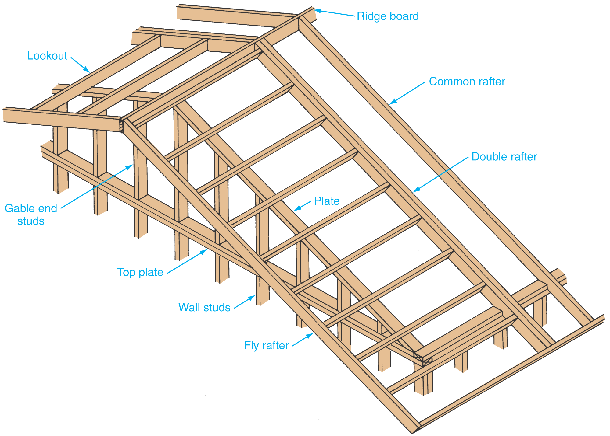
Gable End Framing
Framing for a gable end with a wide overhang.

Slide 38
Roof Trusses
The roof truss is an assembly of members that form a rigid framework.
Information needed to purchase a truss includes the span, roof pitch, spacing of trusses, and roof load.
Lightweight wood trusses generally can span distances of 20' to 32'.
Residential trusses are generally 2" x 4" or 2" x 6" lumber.

Slide 39
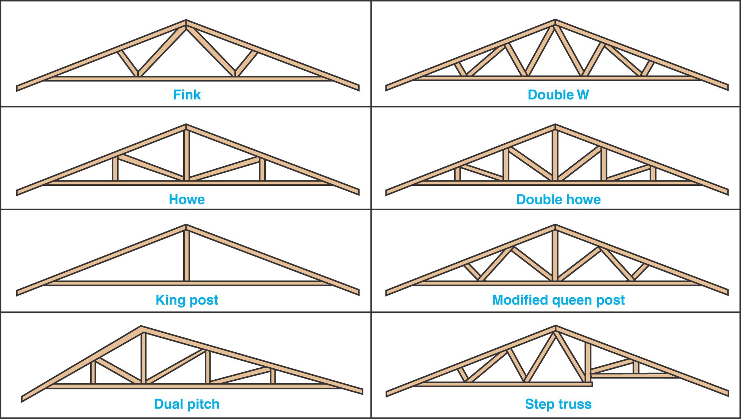
Common Roof Truss Designs

Slide 40
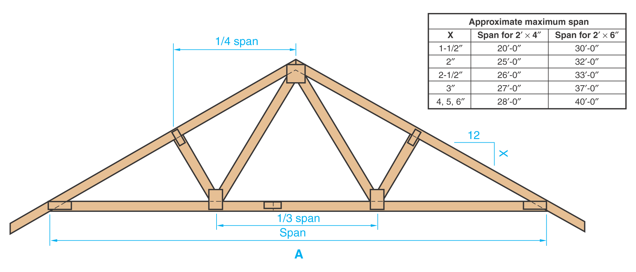
W-Type Truss
Three types of wood trusses are commonly used in residential construction: W-type truss, king-post or K-post truss, and scissors truss.

Slide 41
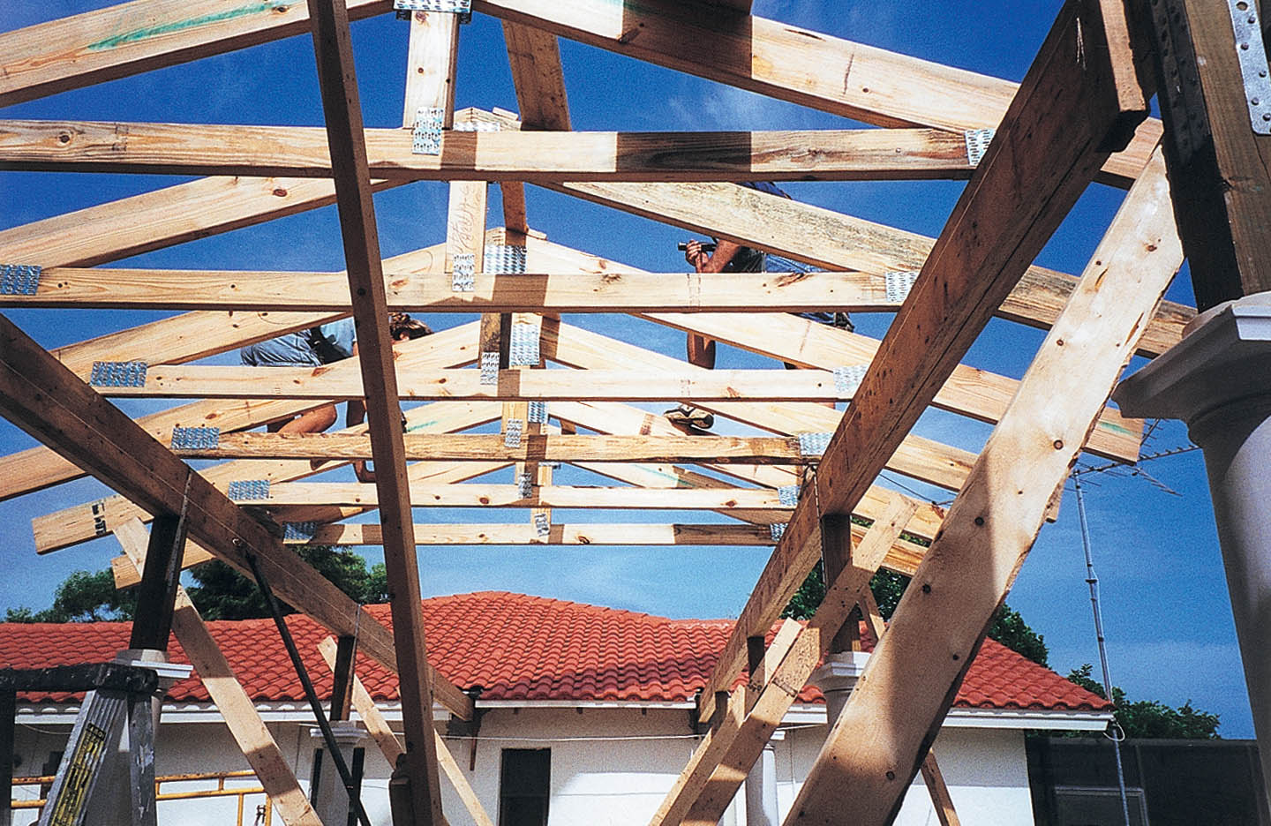
Gusset Plates
Gussets are frequently used to fasten the members of a wood truss together. They are generally made from metal.

Slide 42
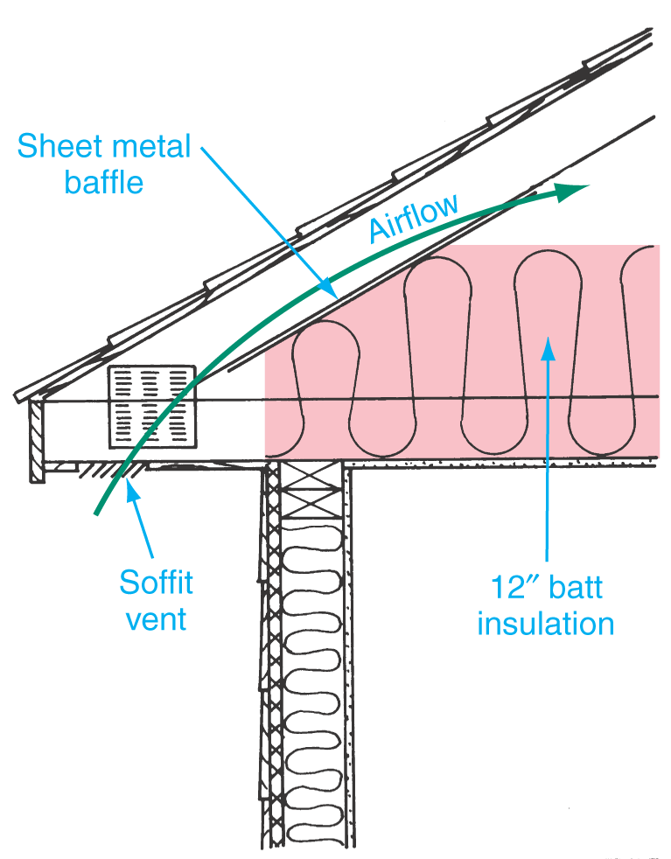
Roof Trusses
When the bottom chord of the truss extends beyond the exterior wall, additional insulation may be added.

Slide 43
Ventilation
Attic ventilation is a necessity.
Attic ventilation reduces moisture condensation under the sheathing.
Ventilation helps cool the house interior during warm weather.
Screened openings in the overhang or ridge ventilators provide ventilation.

Slide 44
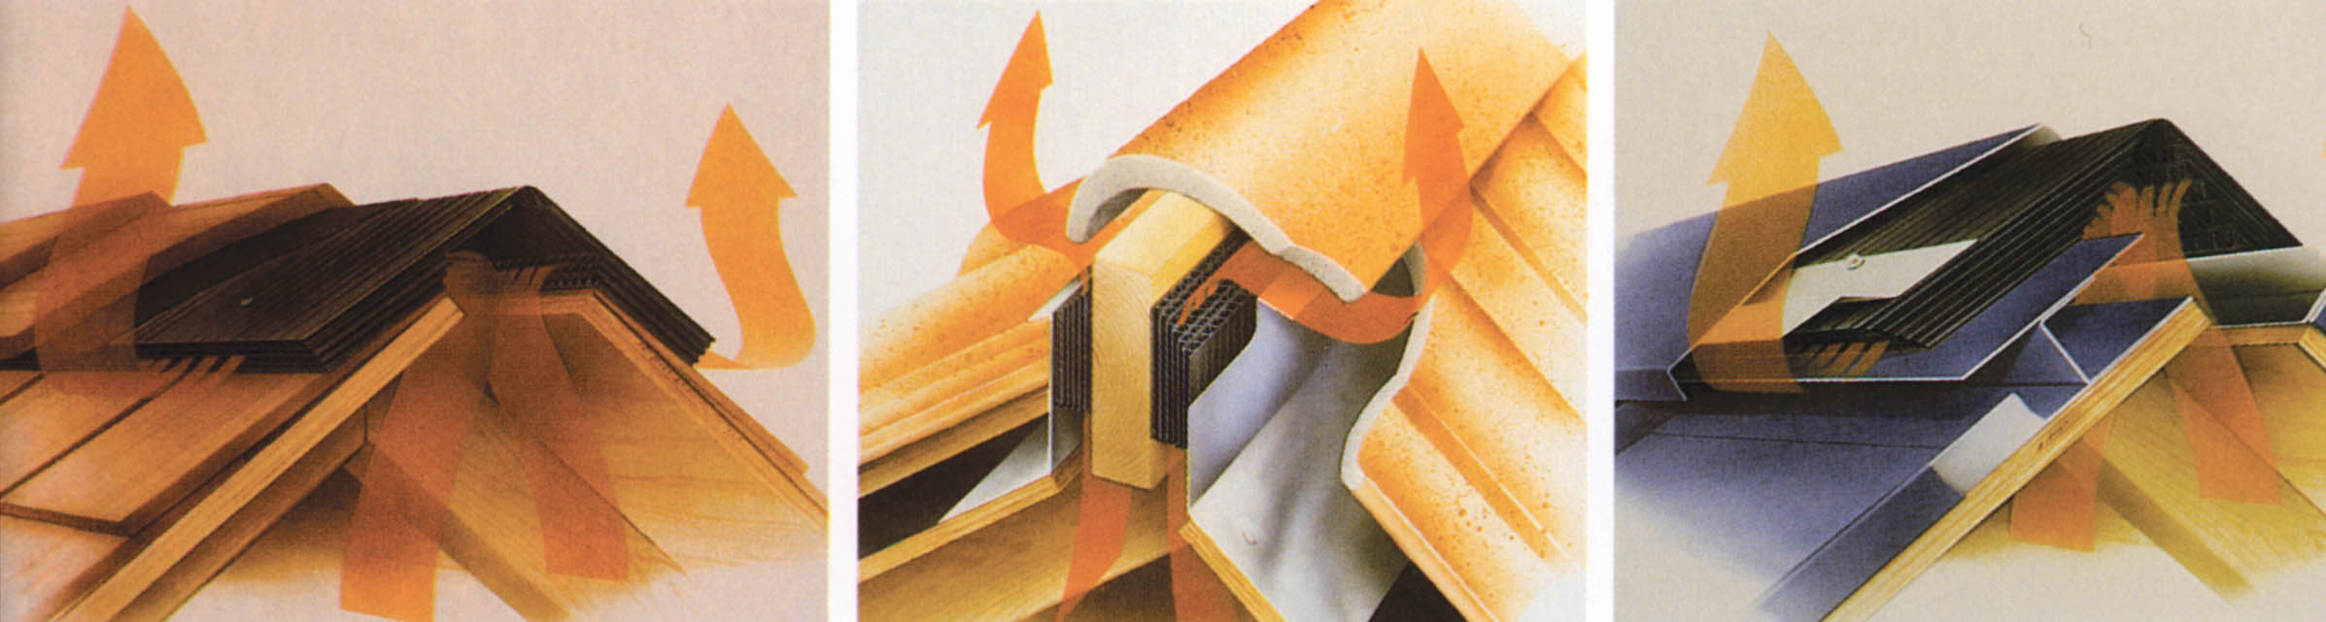
Ridge Ventilators
(Cor-A-Vent, Inc.)

Slide 45
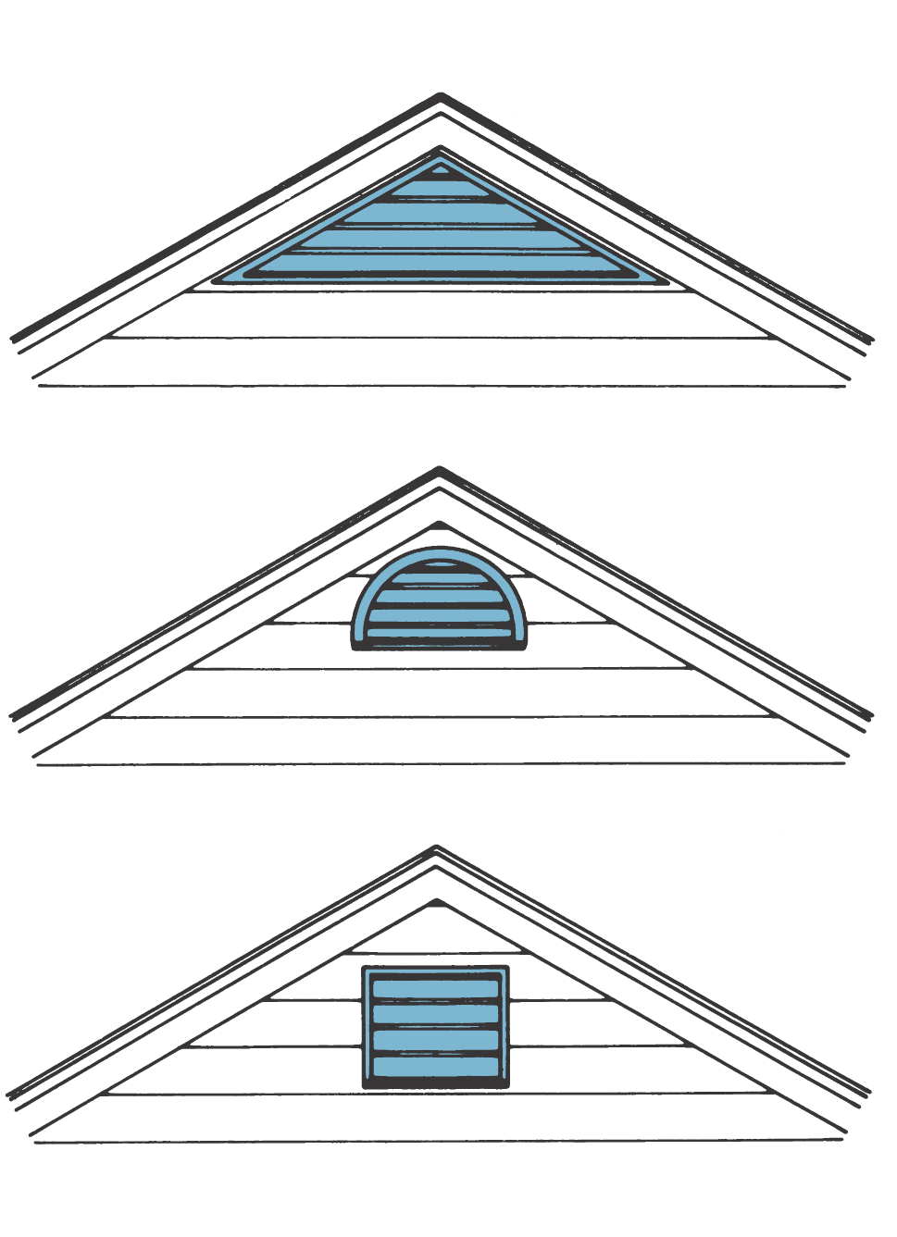
Gable-Type Ventilators
Ventilator openings should be at least 1/300th of the ceiling area.

Slide 46
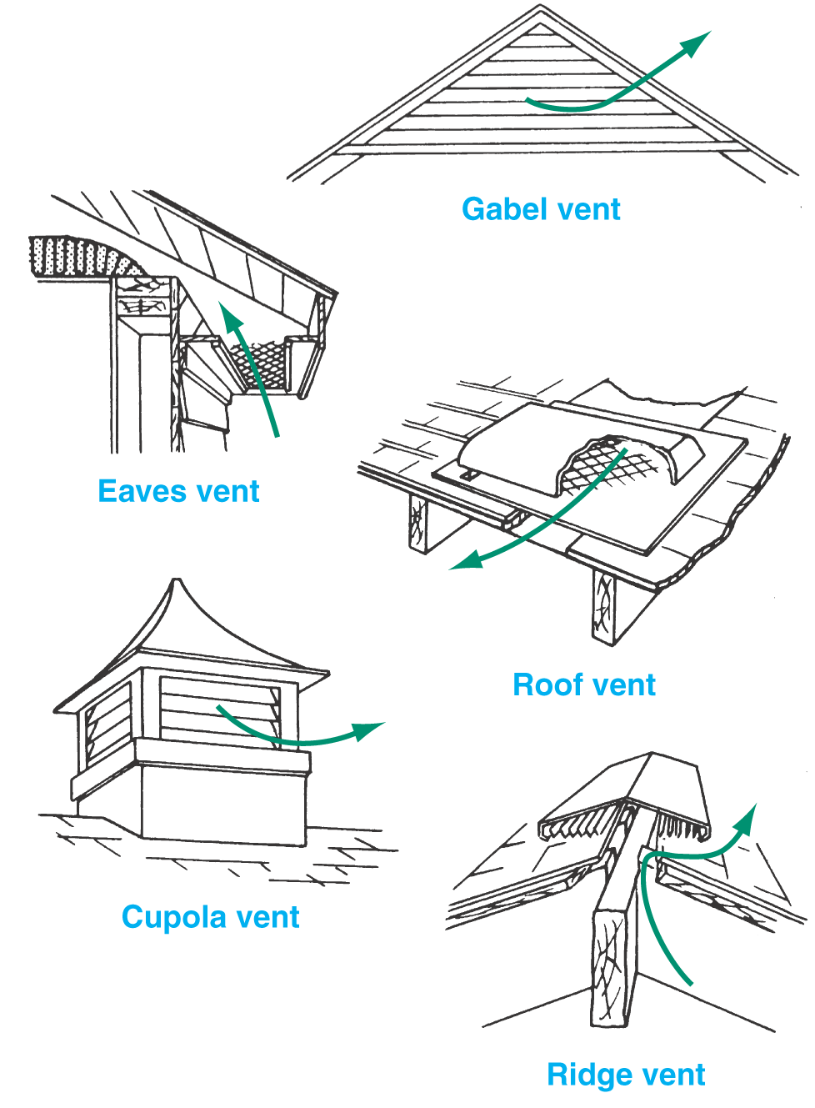
Roof Ventilation Methods

Slide 47
Flashing
Flashing is used to repel water from areas of potential leakage.
Flashing should be used where the roof contacts a wall, chimney, roof valley, or at any roof penetration.
Flashing may be metal or 90-pound roll roofing.
Proper flashing must be installed.

Slide 48
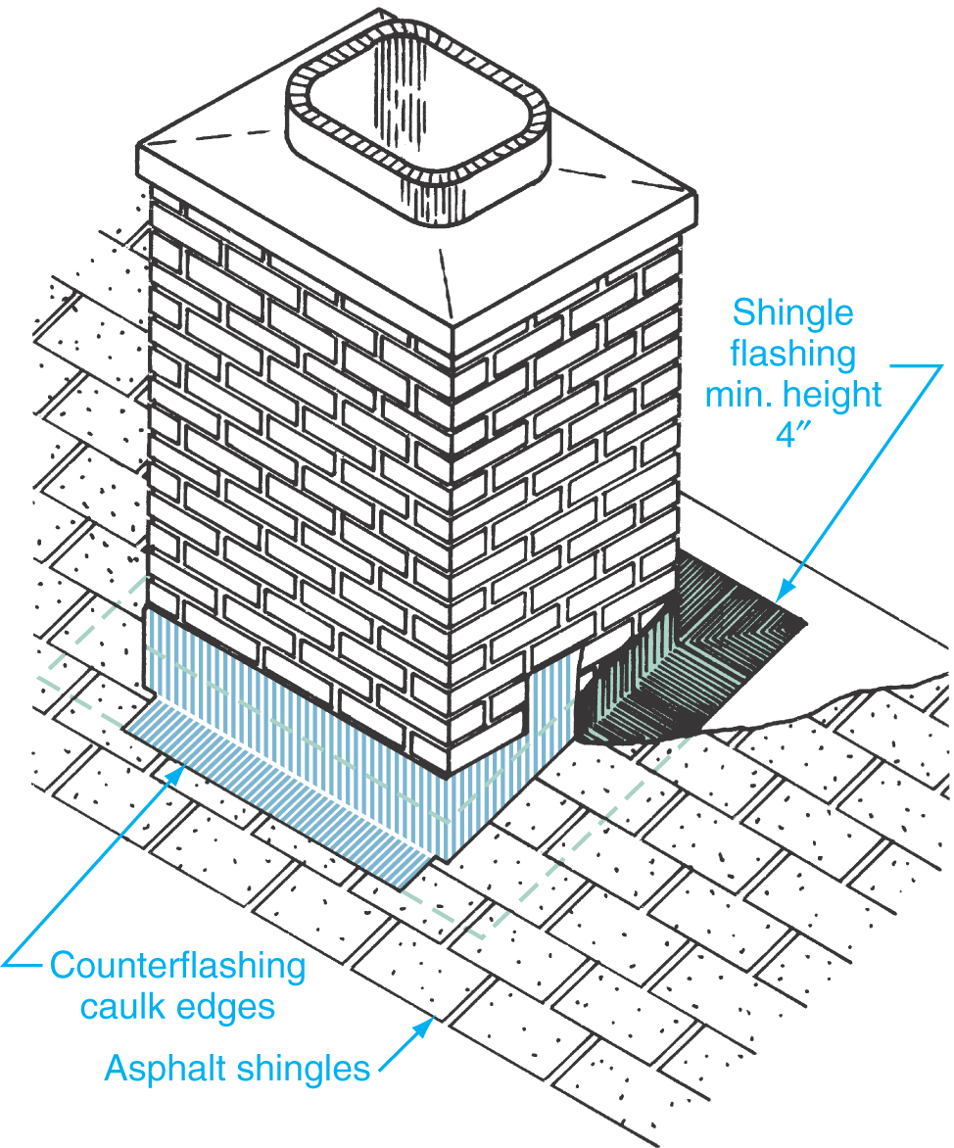
Chimney Flashing
Flashing around the chimney is composed of shingle flashing and counterflashing.

Slide 49
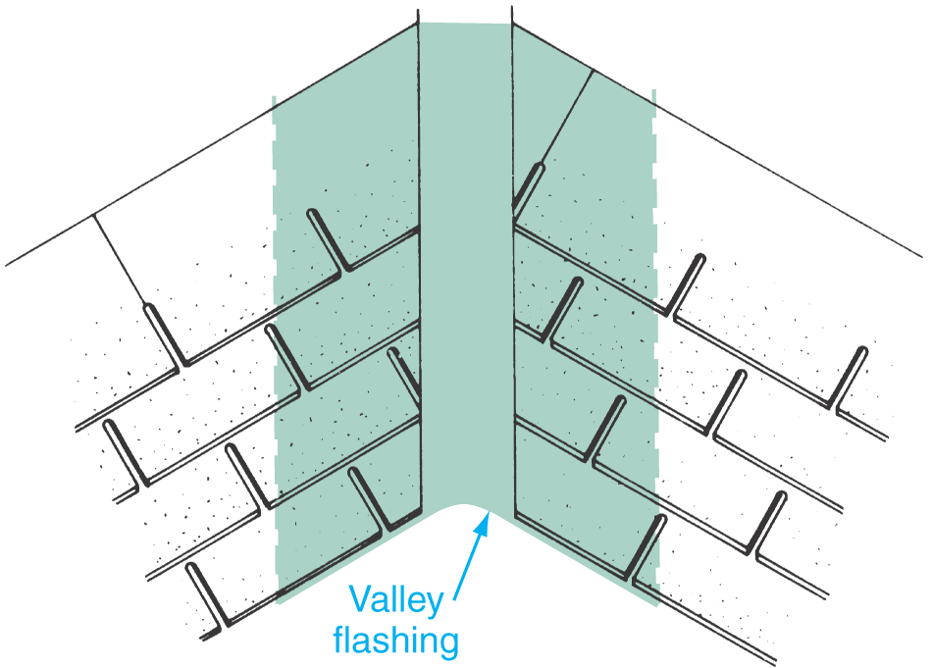
Valley Flashing
The width of valley flashing is dependent upon the roof slope but should not be less than 12".

Slide 50
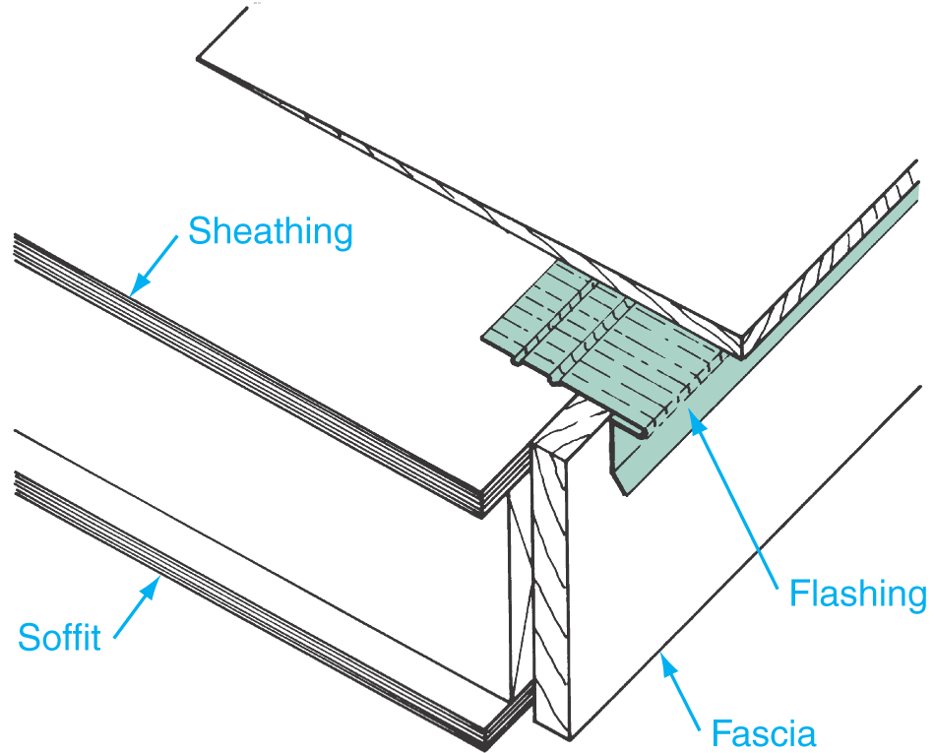
Drip Edge Flashing
Drip edge flashing prevents water from entering behind the shingles and protects the fascia or rake boards.

Slide 51
Gutters and Downspouts
Gutters collect water from the roof and direct it to a downspout.
Gutters prevent water from running directly off the eaves and splattering the house.
They are sloped about 1" per 20'.
Several styles are available in copper, vinyl, aluminum, and galvanized steel.

Slide 52
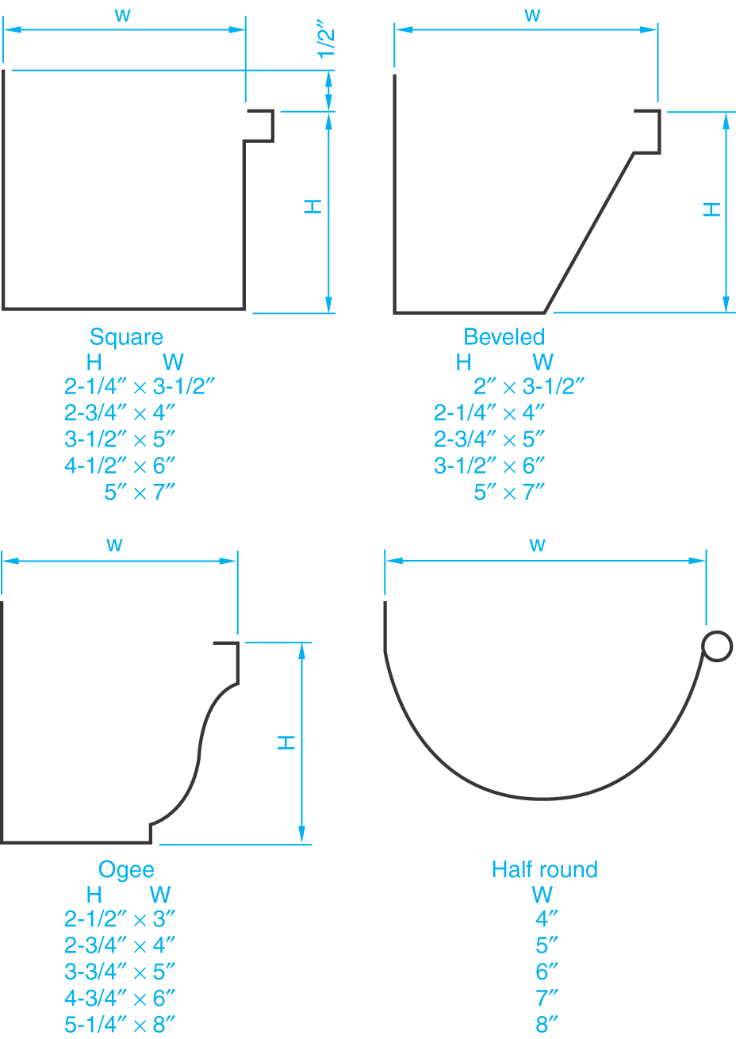
Gutter Designs and Sizes

Slide 53
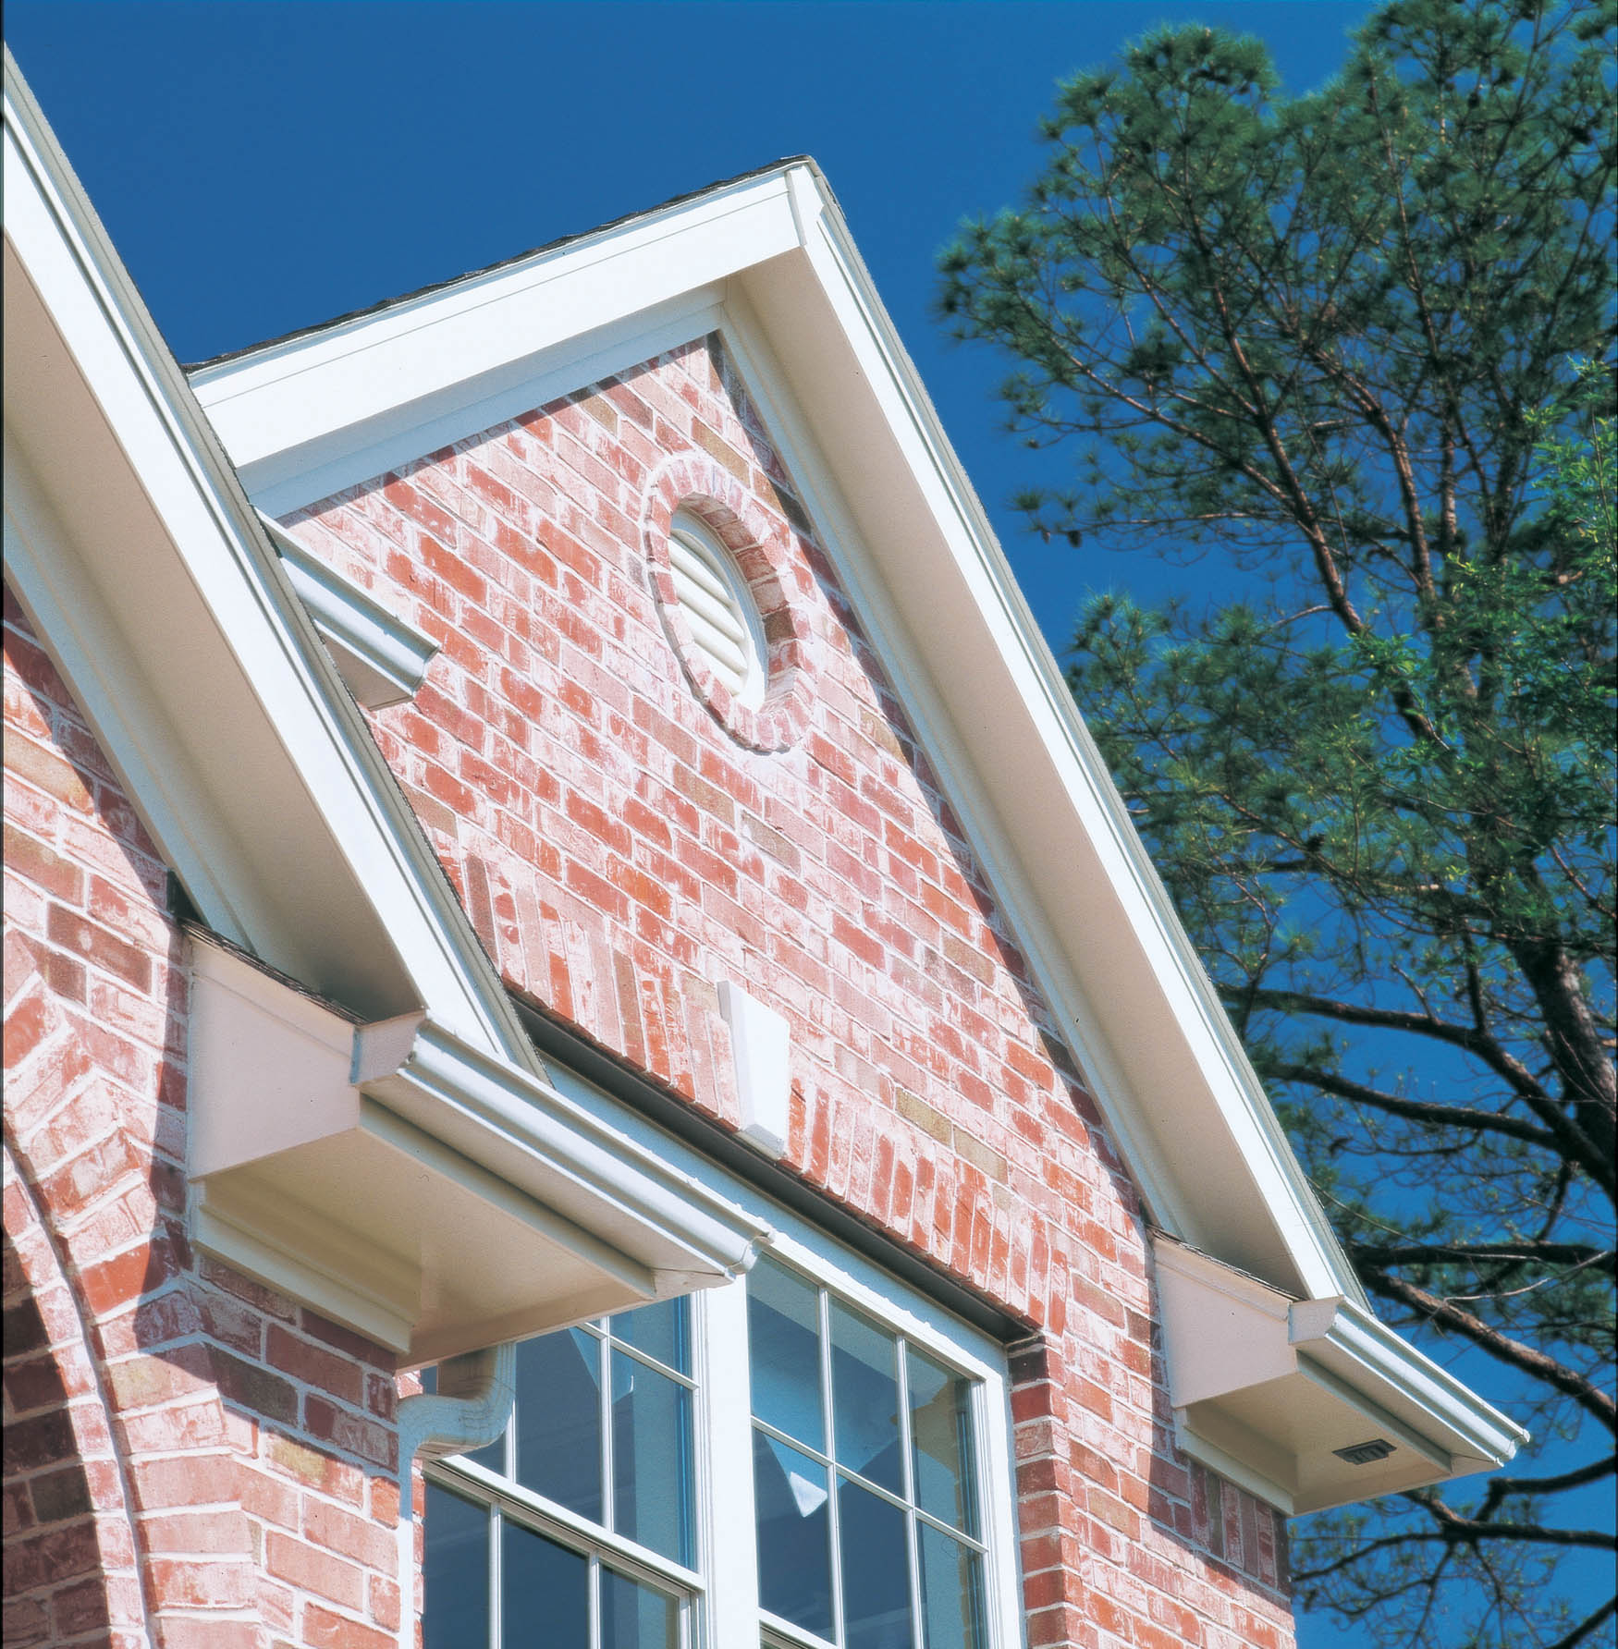
Ogee-Style Gutter

Slide 54
Roof Sheathing and Roofing
Roof sheathing supports the roofing material.
Sheathing is generally plywood or other approved panel products.
Sheathing thickness depends on spacing of the rafters.
1/2" sheathing-grade plywood is generally used when rafters are 16"OC.

Slide 55
Roofing Materials
Asphalt shingles are the most popular type of roofing material for residences.
Usual weight is 235 pounds per square.
A “square” of shingles covers 100 square feet.
A layer of 15-pound saturated-felt building paper is usually placed between the sheathing and shingles.

Slide 56
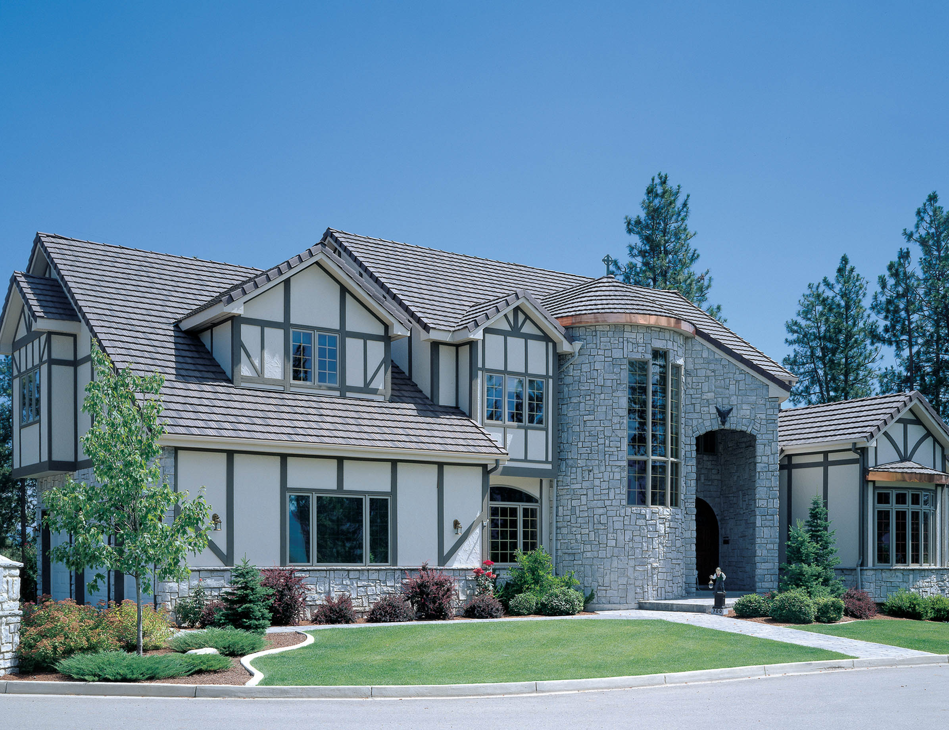
Asphalt Laminate Shingles
Asphalt laminate shingles are beginning to replace traditional asphalt shingles. Laminates are thicker, heavier, more wind resistant, and appear three-dimensional.

Slide 57
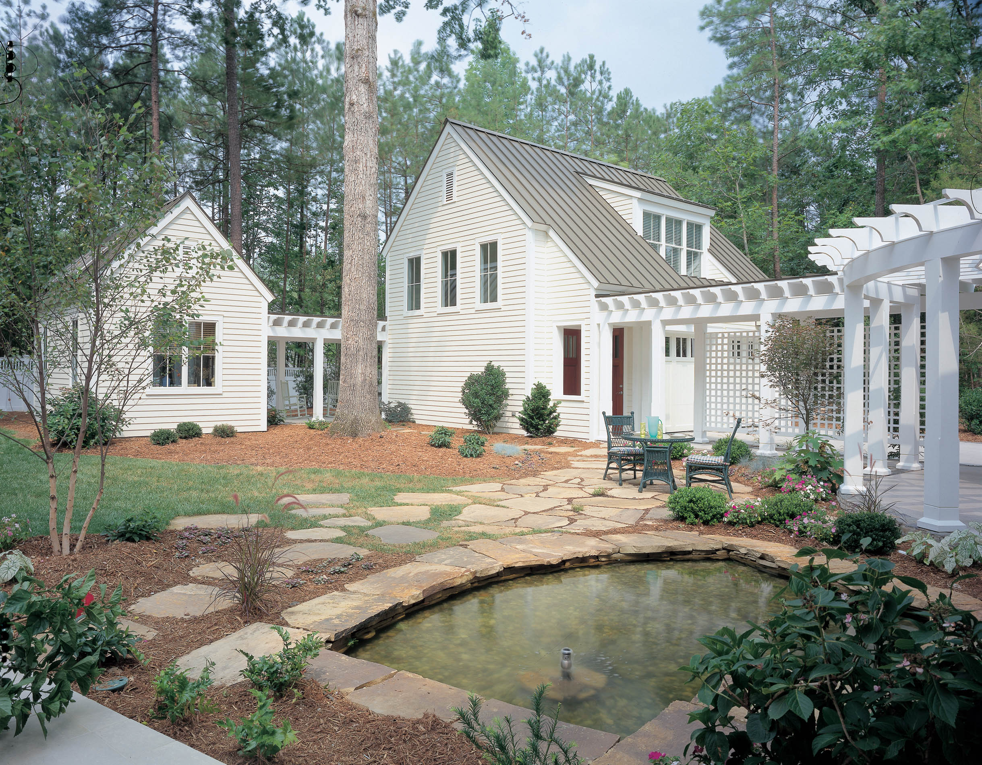
Metal Roofing
Metal roofing is gaining wider acceptance for residential construction. Metal roofing can resist high winds and simulate other roofing materials.

Slide 58
Glossary
Box Cornice.
A cornice that has the space between the end of a projecting rafter and the wall enclosed with a soffit board.
Clear Span.
The horizontal distance from the inside of one exterior stud wall to the inside of the opposite exterior stud wall.
Close Cornice.
A cornice in which the rafter does not project beyond the wall.

Slide 59
Glossary
Cornice.
The overhang of the roof at the eave line that forms a connection between the roof and side walls.
Downspout.
A vertical pipe that receives the water from the gutter outlet.
Flashing.
Used to shed water away from areas of potential leakage.

Slide 60
Glossary
Free-Form Roof.
A roof that offers complete freedom of design; urethane foam is a popular choice of material for this roof.
Gable End.
The extension of a gable roof beyond the end wall of the house; also called the rake.
Gussets.
Used to fasten the members of a wood truss together.

Slide 61
Glossary
Gutters.
Collect the water from the roof and direct it to an outlet.
Narrow Box Cornice.
A cornice that is usually between 6" and 12" wide; the soffit board is nailed directly to the bottom side of the rafters.
Open Cornice.
A cornice that may be used with exposed-beam construction, contemporary, or rustic designs.

Slide 62
Glossary
Parasol Roof.
A roof that looks like an upturned parasol (umbrella); usually constructed from concrete.
Rafter.
The most basic member of roof framing.
Rake.
The extension of a gable roof beyond the end wall of the house; also called the gable end.
Rise.
The vertical distance of a roof measured from the top of the wall plate to the underside of the rafters.

Slide 63
Glossary
Roof Sheathing.
Placed over the rafters to support the roofing material.
Roof Slope.
The slant of the roof.
Roof Truss.
An assembly of members that form a rigid framework of triangular shapes.
Run.
One-half the distance of the clear span of a roof.

Slide 64
Glossary
Warped Roof.
Limitless in design; these roofs may be constructed from concrete, molded plywood, or plastics.
Wide Box Cornice with Lookouts.
A cornice that normally requires additional support members, called lookouts, for fastening the soffit.
Wide Box Cornice without Lookouts.
A cornice that has a sloped soffit; the soffit material is nailed to the underside of the rafters.

