Slide 1
Precise Measurements
Using Vernier Calipers

Slide 2
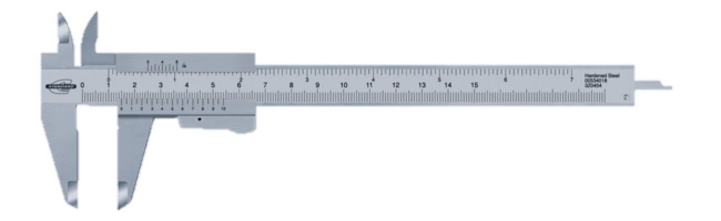
Calipers
Caliper – a device used to measure the distance between two opposite sides of an object.
History
  The earliest caliper dates back to the Greeks and Romans during the 6th century BC.
  Vernier Caliper – invented by American Joseph Brown in 1851.

Slide 3
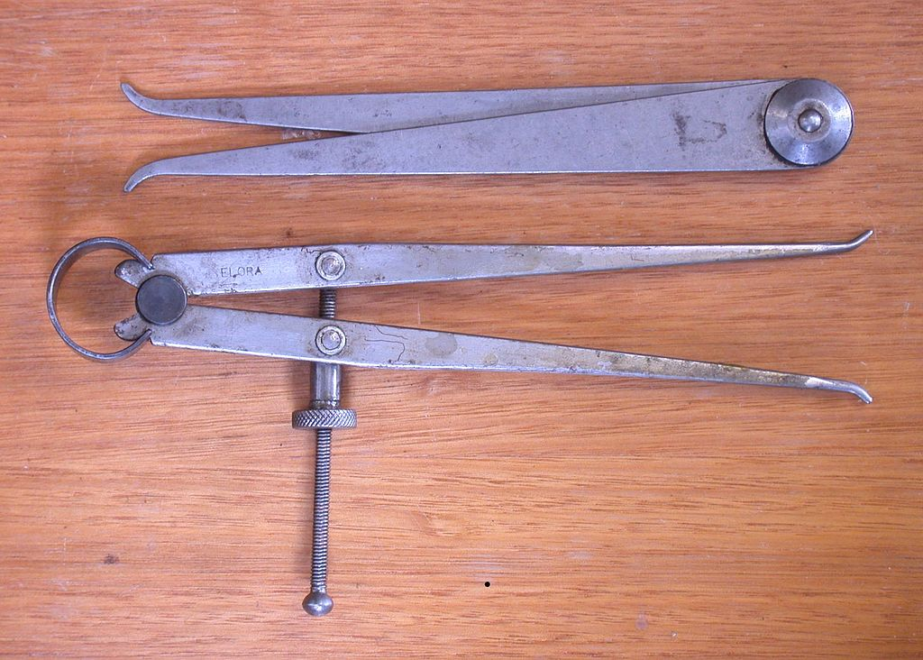
Used to measure the internal size of an object.
Types of Calipers
Inside Caliper

Slide 4
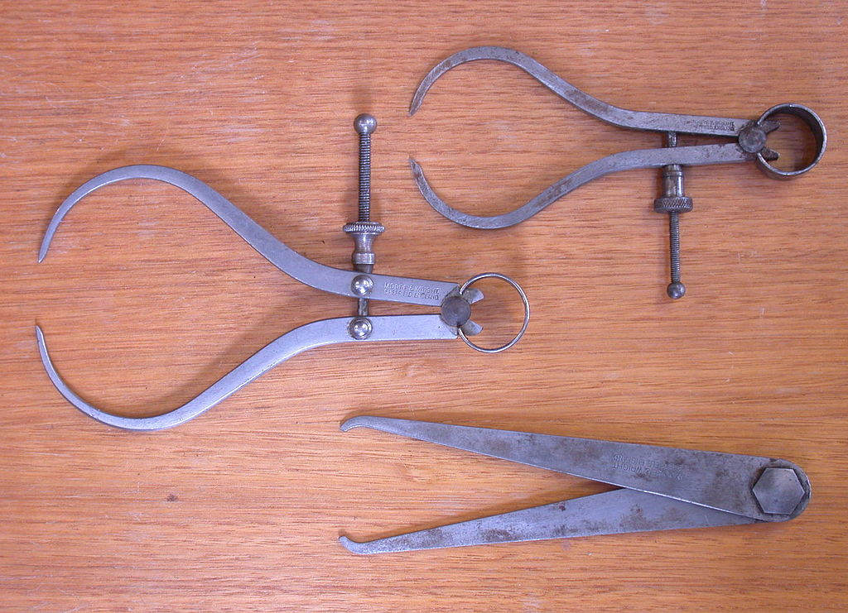
Used to measure the external size of an object.
Types of Calipers
Inside Caliper
Outside Caliper

Slide 5
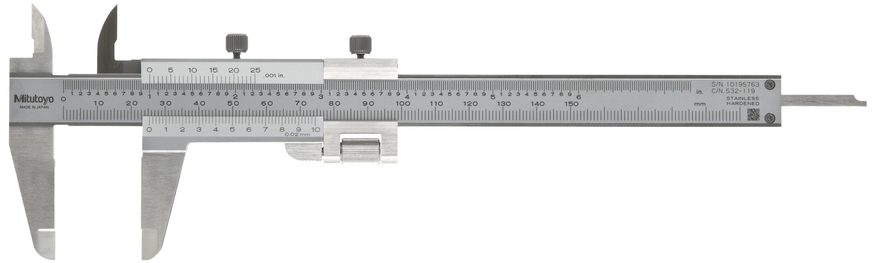
Used to measure with very high accuracy and precision. Uses a Vernier scale to measure external width, internal width and the depth of an object.
Types of Calipers
Inside Caliper
Outside Caliper
Vernier Caliper

Slide 6
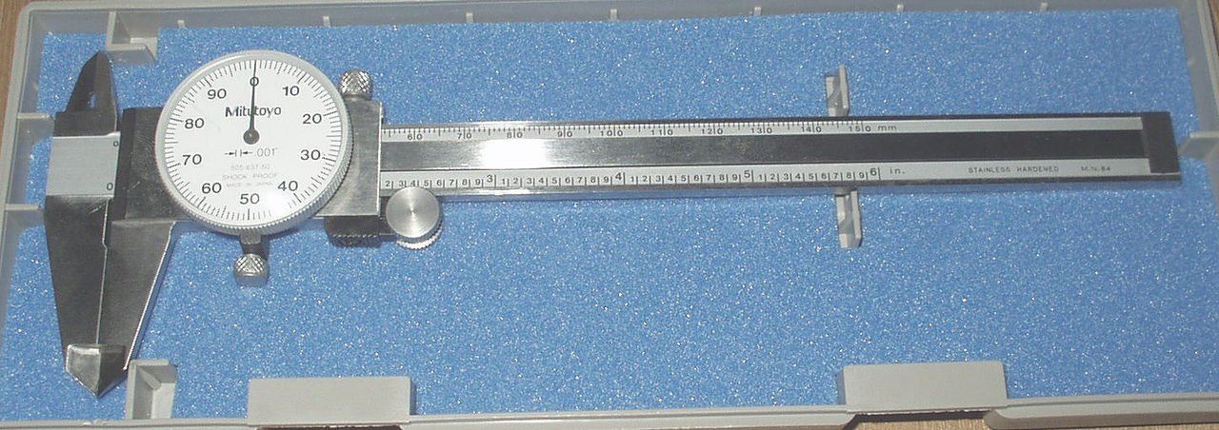
Used to measure with very high accuracy and precision. Uses a dial scale to measure external width, internal width and the depth of an object.
Types of Calipers
Inside Caliper
Outside Caliper
Vernier Caliper
Dial Caliper

Slide 7
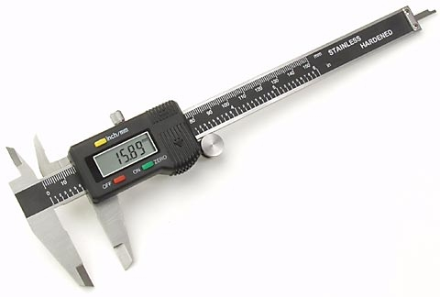
Used to measure with very high accuracy and precision. Uses a digital scale to measure external width, internal width and the depth of an object.
Types of Calipers
Inside Caliper
Outside Caliper
Vernier Caliper
Dial Caliper
Digital Caliper

Slide 8
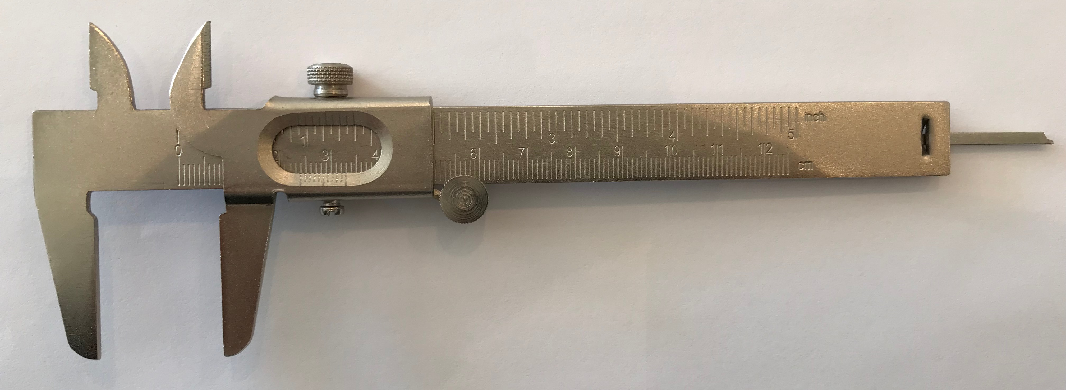
Vernier Caliper
Inside Small Jaws
Imperial Vernier Scale
Depth Probe
Metric Vernier Scale
Main Scale
Outside Large Jaws
Outside Large Jaws: used to measure external width of an object.
Inside Small Jaws: used to measure internal width of an object.
Depth Probe: used to measure depths of an object or hole.
Main Scale: scale marked every mm and inch fractions
Vernier Scale: gives measurements to 0.05mm or better and measurements in a
fraction of an inch.

Slide 9
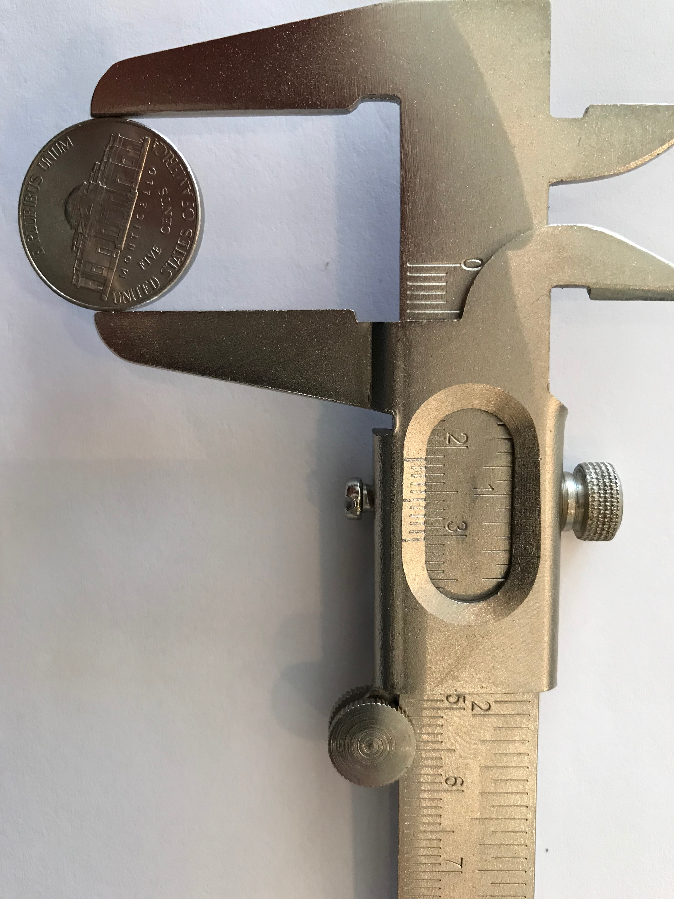
Vernier Caliper: External Measurement

Slide 10
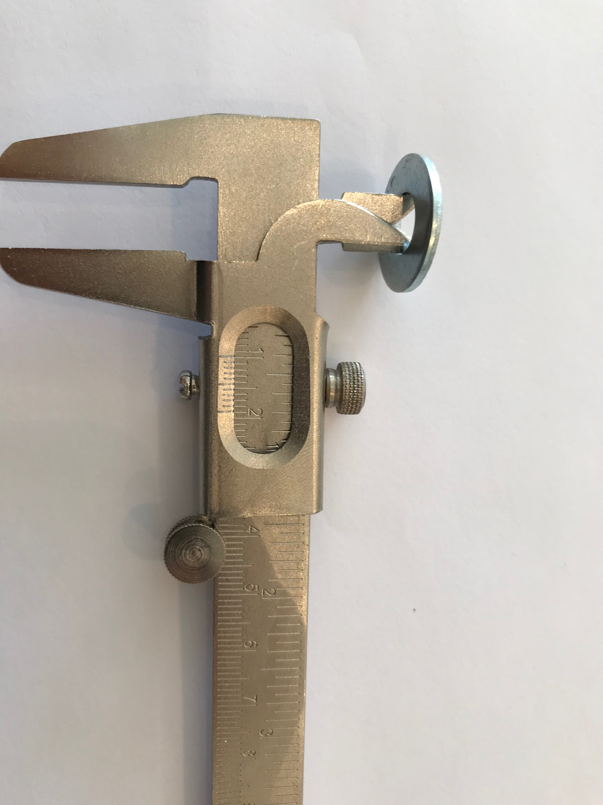
Vernier Caliper: Internal Measurement

Slide 11
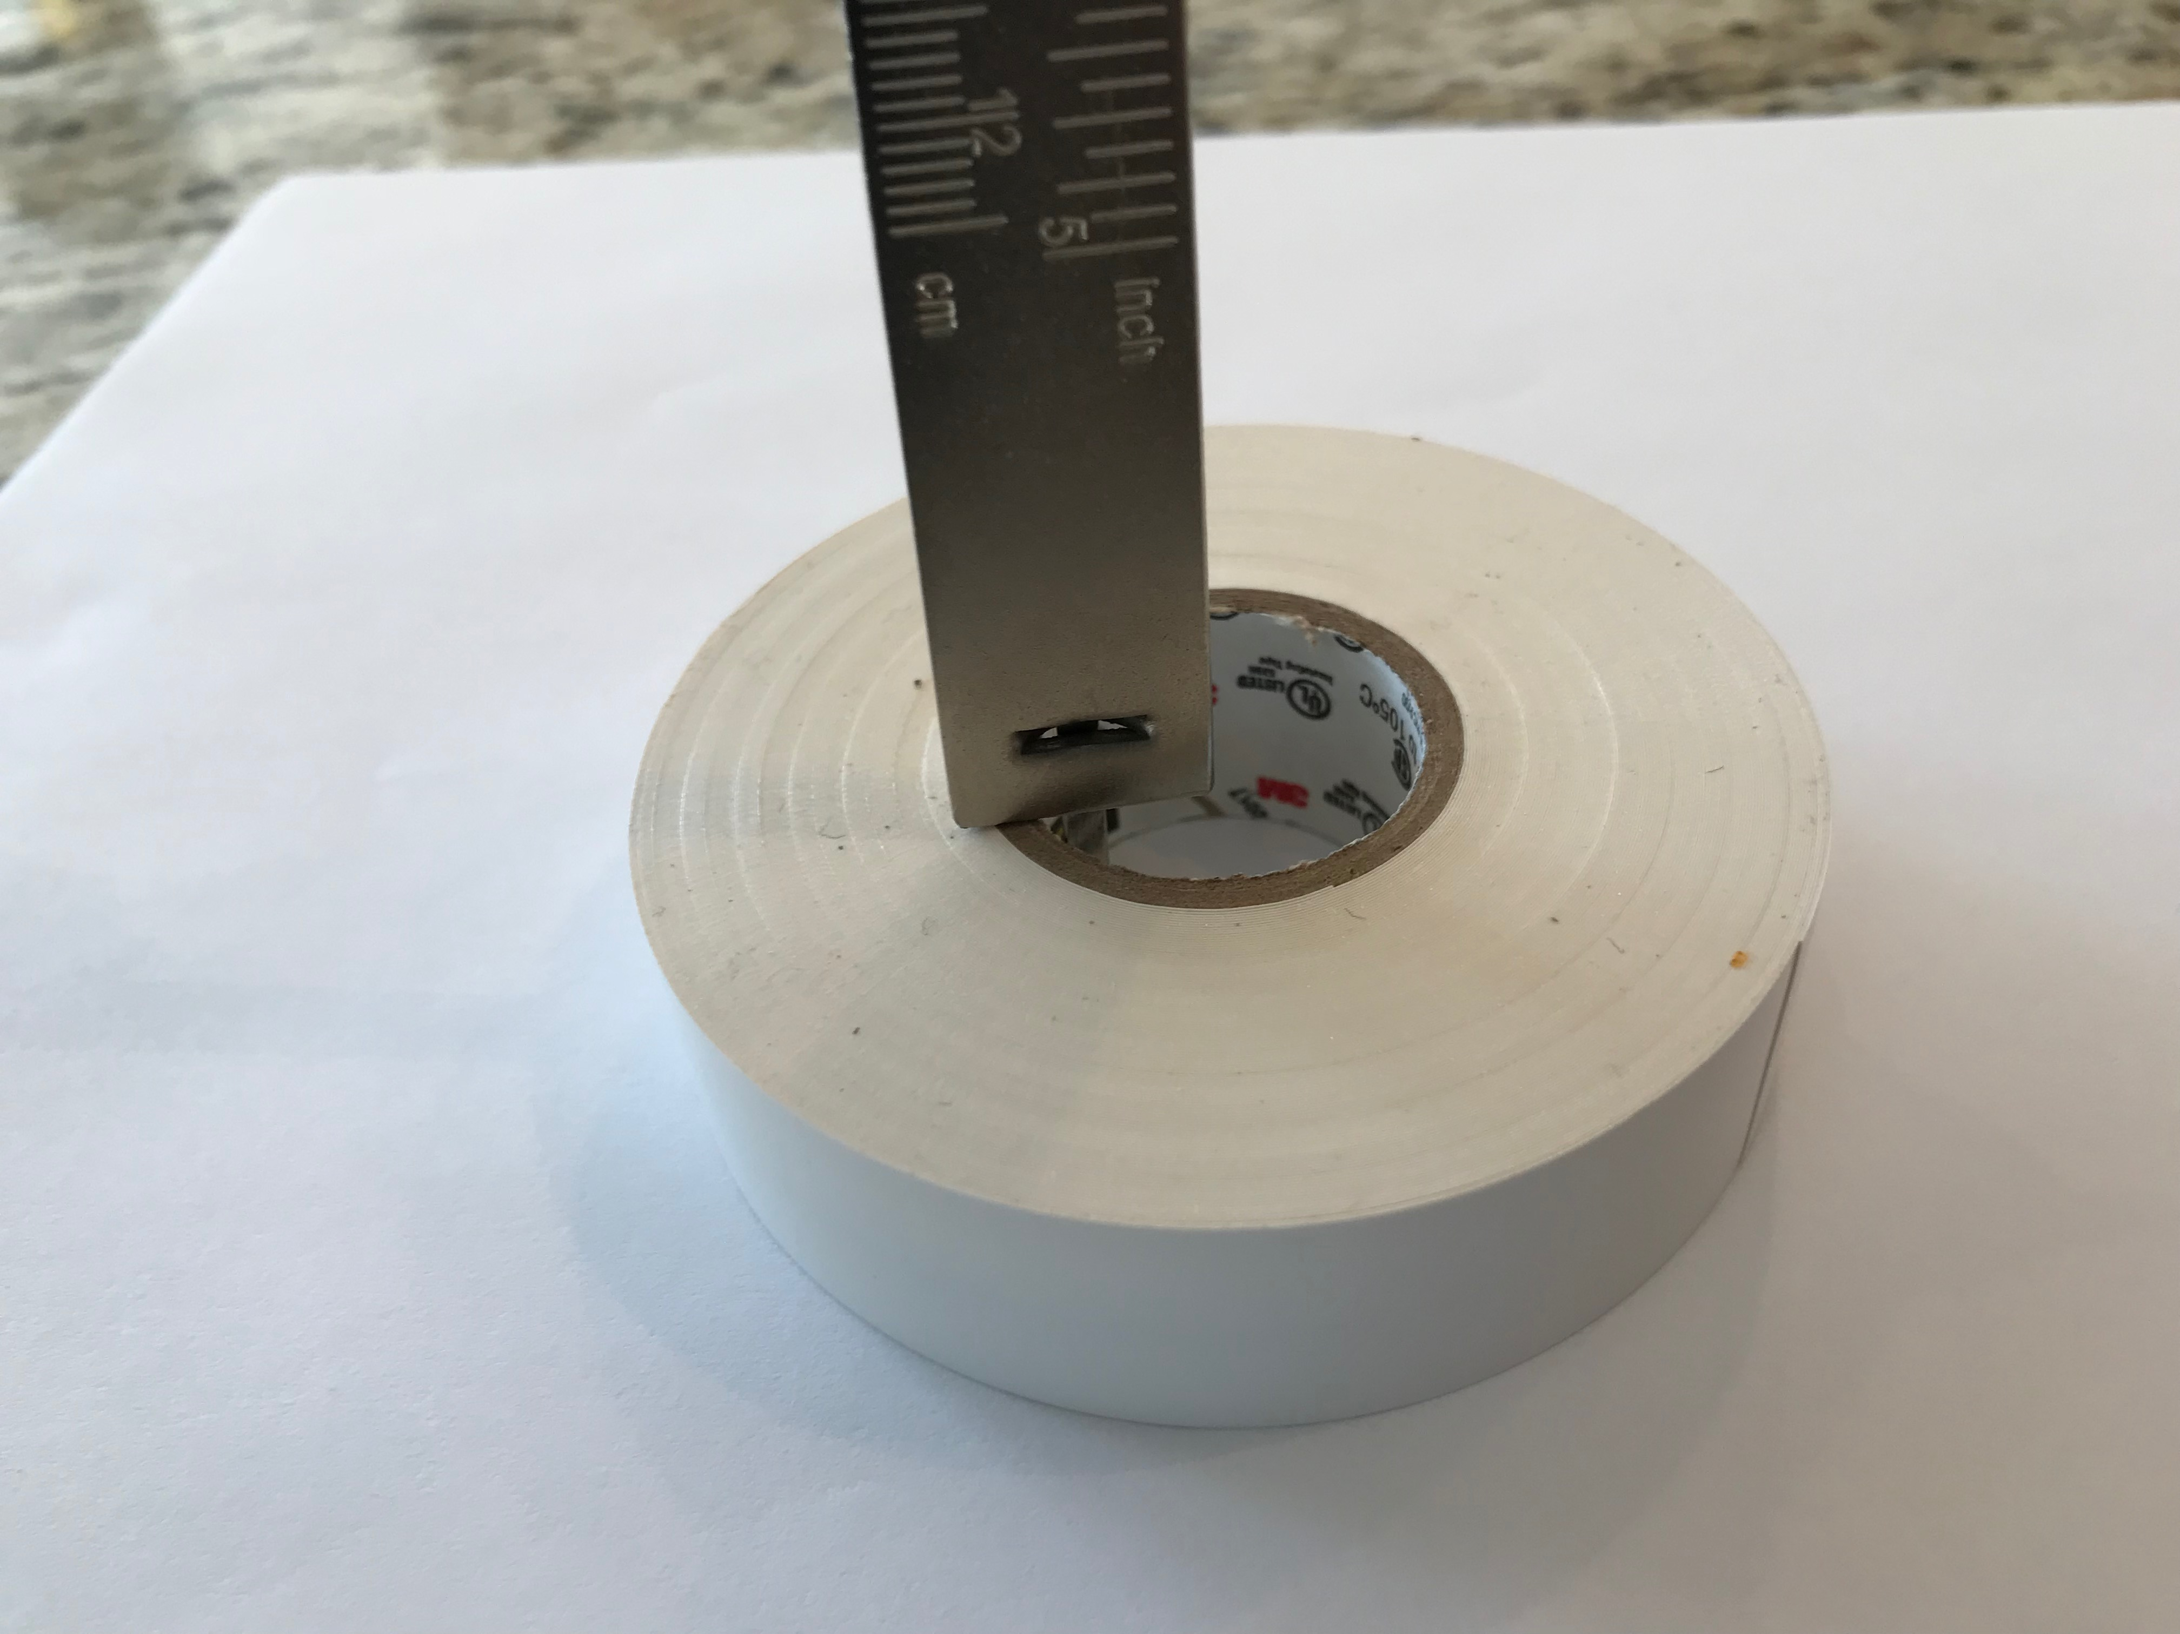
Vernier Caliper: Depth Measurement

Slide 12
Measuring for Vernier Caliper
Metric readings

Slide 13
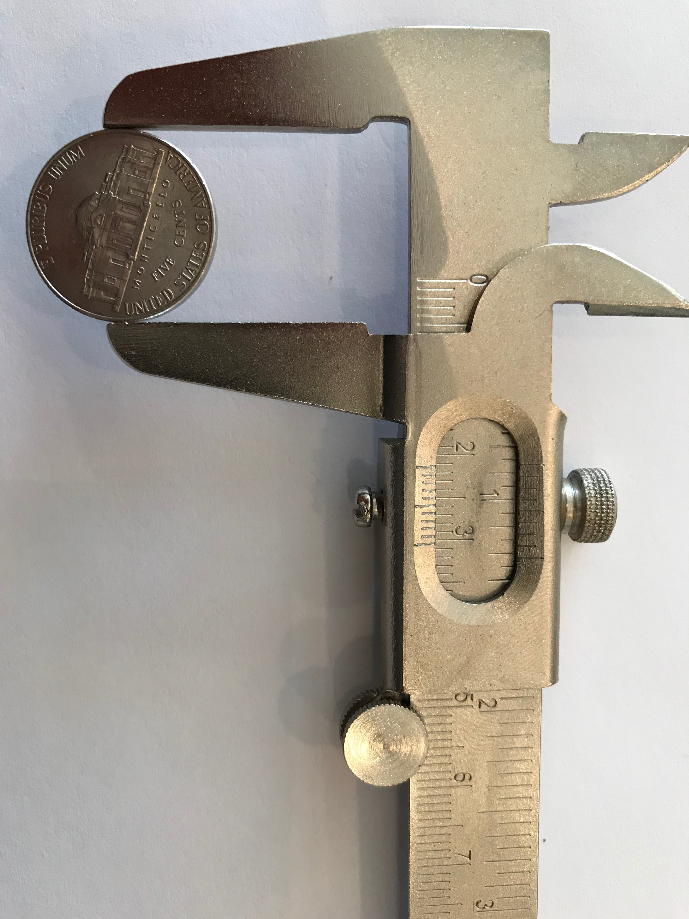
Measuring for Vernier Caliper: Metric
Total Reading = Main Scale Reading + Vernier Scale Reading
Read the “0” position of the Vernier Scale on the Main scale to get the rough reading.
Reading: 21mm (Just past 21mm, but not lined up with 22mm

Slide 14
Measuring for Vernier Caliper: Metric
Total Reading = 21 + Vernier Scale Reading
Read the Vernier scale. Pick the measurement that “lines up” the best to the main scale.
Vernier Scale: 0.0 0.1 0.2 0.3 0.4 0.5….etc

Slide 15
Measuring for Vernier Caliper: Metric
Total Reading = 21 + Vernier Scale Reading
Read the Vernier scale. Pick the first measurement that “lines up” the best to the main scale.
Reading: 0.3mm

Slide 16
Measuring for Vernier Caliper: Metric
Total Reading = 21 + 0.3 = 21.3mm
Add the main scale reading to the Vernier scale reading to get the total reading.

Slide 17
Measuring for Vernier Caliper
Imperial readings

Slide 18
Measuring for Vernier Caliper: Imperial
Total Reading = Main Scale Whole Reading + Main Scale Sub Reading + Vernier Scale Reading
Read the “0” position of the Vernier Scale on the Main scale to get the whole reading.
Reading: Under 1 inch. Main Scale Whole Reading = 0 inches.

Slide 19
Measuring for Vernier Caliper: Imperial
Total Reading = 0 + Main Scale Sub Reading + Vernier Scale Reading
Read the “0” position of the Vernier Scale on the Main scale to get the sub reading.
Reading: 12/16, 13/16, 14/16, 15/16, 16/16. Past 13/16 but not quite 14/16.

Slide 20
Measuring for Vernier Caliper: Imperial
Total Reading = 0 + 13/16 + Vernier Scale Reading
Read the “0” position of the Vernier Scale on the Main scale to get the sub reading.
Reading: 12/16, 13/16, 14/16, 15/16, 16/16. Past 13/16 but not quite 14/16.

Slide 21
Measuring for Vernier Caliper: Imperial
Total Reading = 0 + 13/16 + Vernier Scale Reading
Vernier scale is based on increments of 1/128th of an inch.
Reading: 0/128, 1/128, 2/128, 3/128, 4/128, 5/128, 6/128, 7/128, 8/128.

Slide 22
Measuring for Vernier Caliper: Imperial
Total Reading = 0 + 13/16 + 3/128
Read the Vernier scale. Pick the first measurement that “lines up” the best to the main scale.
Reading: 0/128, 1/128, 2/128, 3/128, 4/128…etc

Slide 23
Measuring for Vernier Caliper: Imperial
Total Reading = 0 + 13/16 + 3/128
Total Reading = 0 + 13/16 or 104/128 + 3/128
Convert 13/16 to the same denominator as Vernier reading…1/128th of an inch
Total Reading = 0 + 104/128 + 3/128 = 107/128
Reading: 0/128, 1/128, 2/128, 3/128, 4/128…etc

