Slide 1
Wood Joints
  How will the joint be used?
  How durable does it need to be?
  What appearance does it have to have?

Slide 2
Wood Joints
Joints
  the securing or fastening together of two or more structural members.
Joint selection depends on:
  The strength
  The appearance
  The difficulty of fabrication
  The equipment available

Slide 3
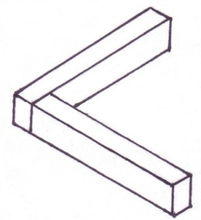

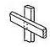
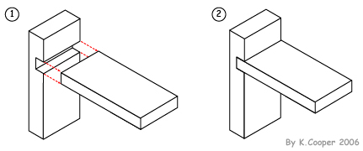
Wood Joints
Butt Joint
Butt Joint
with Gusset
Notch Joint
90 degree
L-Lap Joint
90 degree cross
Lap Joint

Slide 4
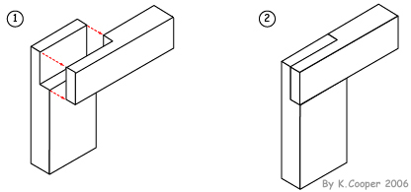
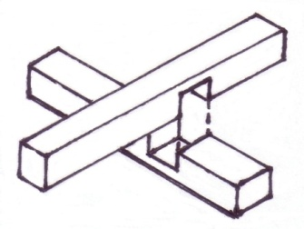
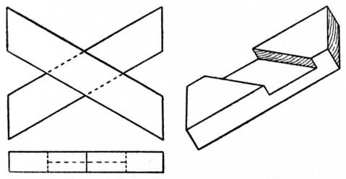
Wood Joints
90 degree
L-Half –Lap
Joint
90 degree
Cross-Half-Lap
Joint
60/120 degree
Cross Half-Lap
Joint
Laminated 2
piece Joint
Laminated 3
piece Joint

