Slide 1
Sectional Views
Section Views

Slide 2
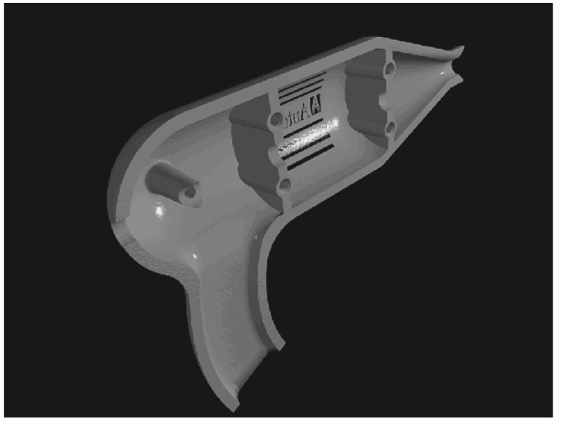
Section Views
Often there is a need to show interiors that cannot be illustrated clearly by hidden lines.
Interiors are shown by slicing through the object resulting in a cutaway view of the part.
Cutaway views are called sectional views, cross sections, or simply sections.

Slide 3
Section Views
The object
Conventional hidden line technique
Many times the interior of an object is so complicated that it is impossible or very difficult to represent that interior with conventional hidden lines.
This often causes confusion in reading and interpreting the drawing. Therefore, sectioning is required in these cases.

Slide 4
Section Views
The object cut
Section technique
Sectioning is a technique by which the object is sliced and the cutaway view of the part is then drawn.
To show the construction clearly in many hollow objects, the front of the part is imagined to be removed to reveal the interior surface.
Where and when this occurs the edges are represented with solid lines and the cut surface is crosshatched or section lined.
The interior detail is now shown more clearly because the hidden lines have been replaced with visible object lines.

Slide 5
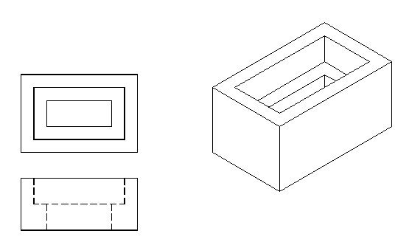
Section Views
Visualizing a section view
Given the object
The top view and front view are shown as a typical orthographic projections with hidden lines.

Slide 6
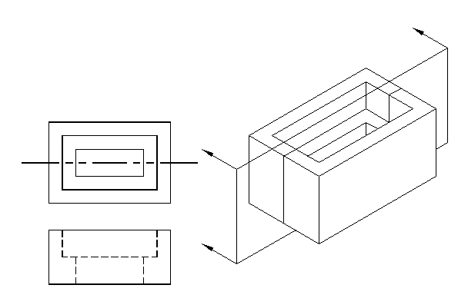
Section Views
Visualizing a section view
A cutting plane is passed through the object, cutting the object.

Slide 7
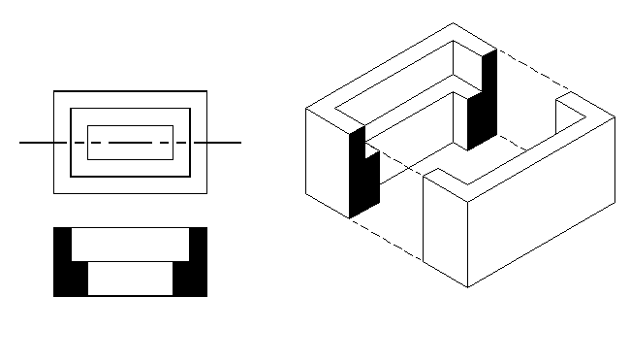
Section Views
Visualizing a section view
The interior detail is now exposed and will appear as visible object lines
To clarify the section view even further, the surfaces touched by the cutting plane are colored to distinguish between solid material and air space.

Slide 8
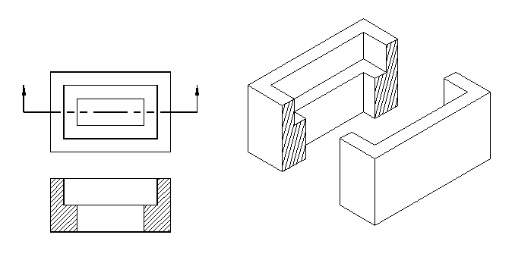
Section Views
Visualizing a section view
A cutting-plane line is used to indicate where the section is being cut. The arrow indicate the direction of sight.
Crosshatching or section lining is applied to the surfaces that are in actual contact with the cutting plane.

Slide 9
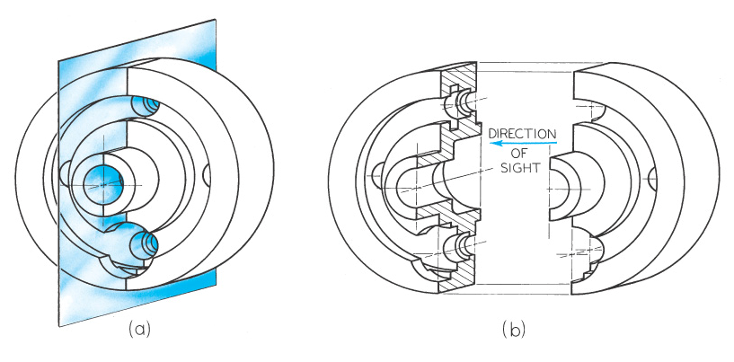
Section Views
To produce a section view a cutting plane is passed through the part (figure a).
The cutting plane is removed and the two halves are drawn apart (figure b) exposing the interior detail.

Slide 10
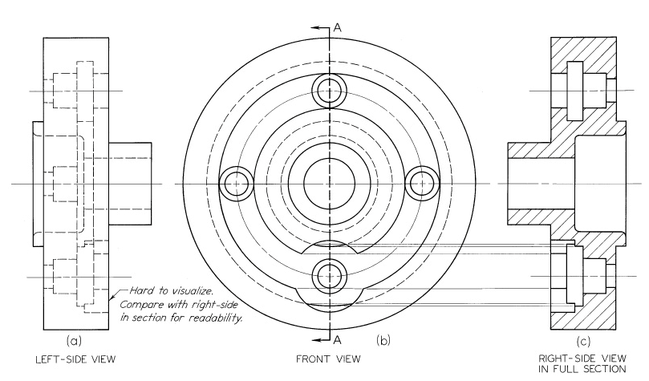
Section Views
To obtain the section view the right half of the front view is only imagined to be removed. The cross-hatched areas of the section view are those portions that are in actual contact with the cutting plane.

Slide 11
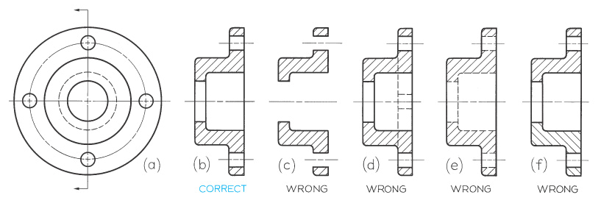
Section Views
A correct front view and section view are shown in figure (a) and figure (b). All visible edges and contours behind the cutting plane should be shown.
Section views are used primarily to replace hidden lines so as a rule hidden lines should be omitted in section views (figure d).
A section-lined area is always completely bounded by a visible outline, never by a hidden line as in figure (e).
Section lines in a section view must be parallel and at the same angle and direction (figure f).

Slide 12
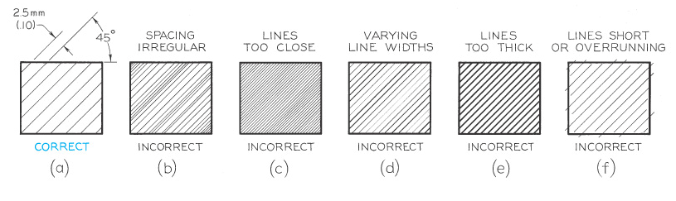
Section Lines
The correct method of drawing section lines is shown in figure (a). Section lines are drawn thin and at an angle of 45 degrees unless there is some advantage in using a different angle. Section lines are spaced evenly approximately 1/16” to 1/8” or more depending on the sectioned area.
In AutoCAD use the Hatch Pattern ANSI31

Slide 13
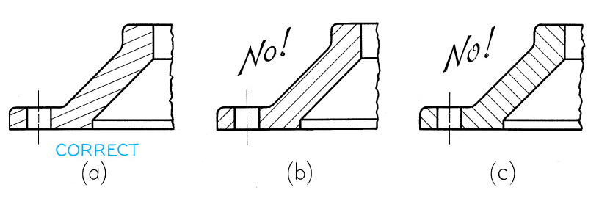
Section Views
If section lines drawn at 45 degrees would result in being parallel or perpendicular to a visible object line the angle should be changed to 30 degrees, 60 degrees, or some other angle.

Slide 14
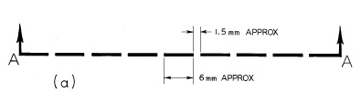
Cutting Plane Lines
The cutting-plane line in figure (a) is composed of equal dashes approximately 1/4” long with arrowheads indicating the direction of sight. For AutoCAD drawings use the line type PHANTOM.

Slide 15
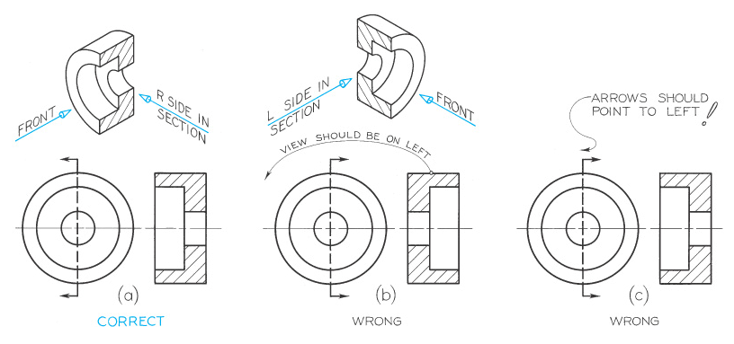
Section Views
Correct and incorrect relations between cutting-plane lines and corresponding section views.

Slide 16
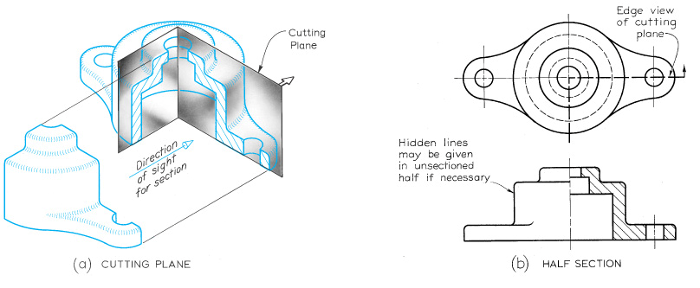
Section Views
Half Sections:
If a cutting plane passes halfway through an object the result is a half section (figure a). The half section has the advantage of showing the interior of one half of the object and the exterior of the other half (figure b).
Note the cutting-plane line. Only one arrowhead is used to show the direction of sight.
Hidden lines should be omitted from both halves of a half section view.
A center line is used to separate the halves of the half section view.

Slide 17
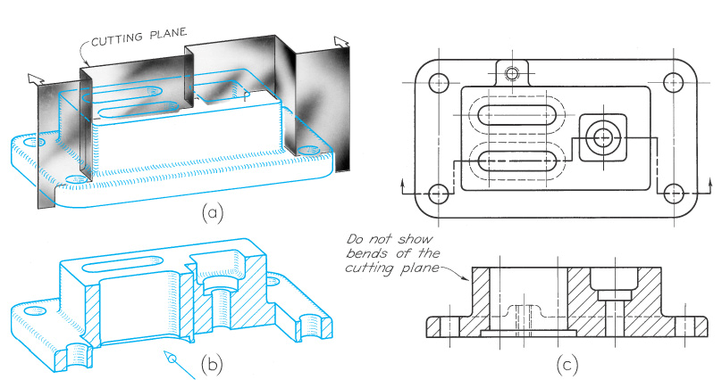
Section Views
Offset Sections:
In sectioning through an irregular object it is often desirable to show features that do not lie in a straight line by offsetting or bending the cutting plane. Such a section is called an offset section.
The offsets or bends in the cutting plane are all 90 degrees and are never shown in the section view.

